Slide 1
Cosmology in the Realm of QSOs and GRBs
Aleksander Łukasz Lenart
aleksander.lenart@student.uj.edu.pl
Astronomical Observatory, Jagiellonian University,
Kraków, Poland
CosmoVerse@Kraków 2024

Slide 2
Our joint research group
Leader: Maria Giovanna Dainotti
Phd students:
Giada Bargiacchi
Aditya Narendra
Biagio de Simone
Mina Ghodsi Yengejeh
Students: Satyajit Chakraborty
Supporting researchers:
Eleonora di Valentino
Salvatore Capozziello
Giovanni Montani
Shigehiro Nagataki
Małgorzata Bogdan
Nissim Fraija
Maria Giovanna Dainotti

Slide 3
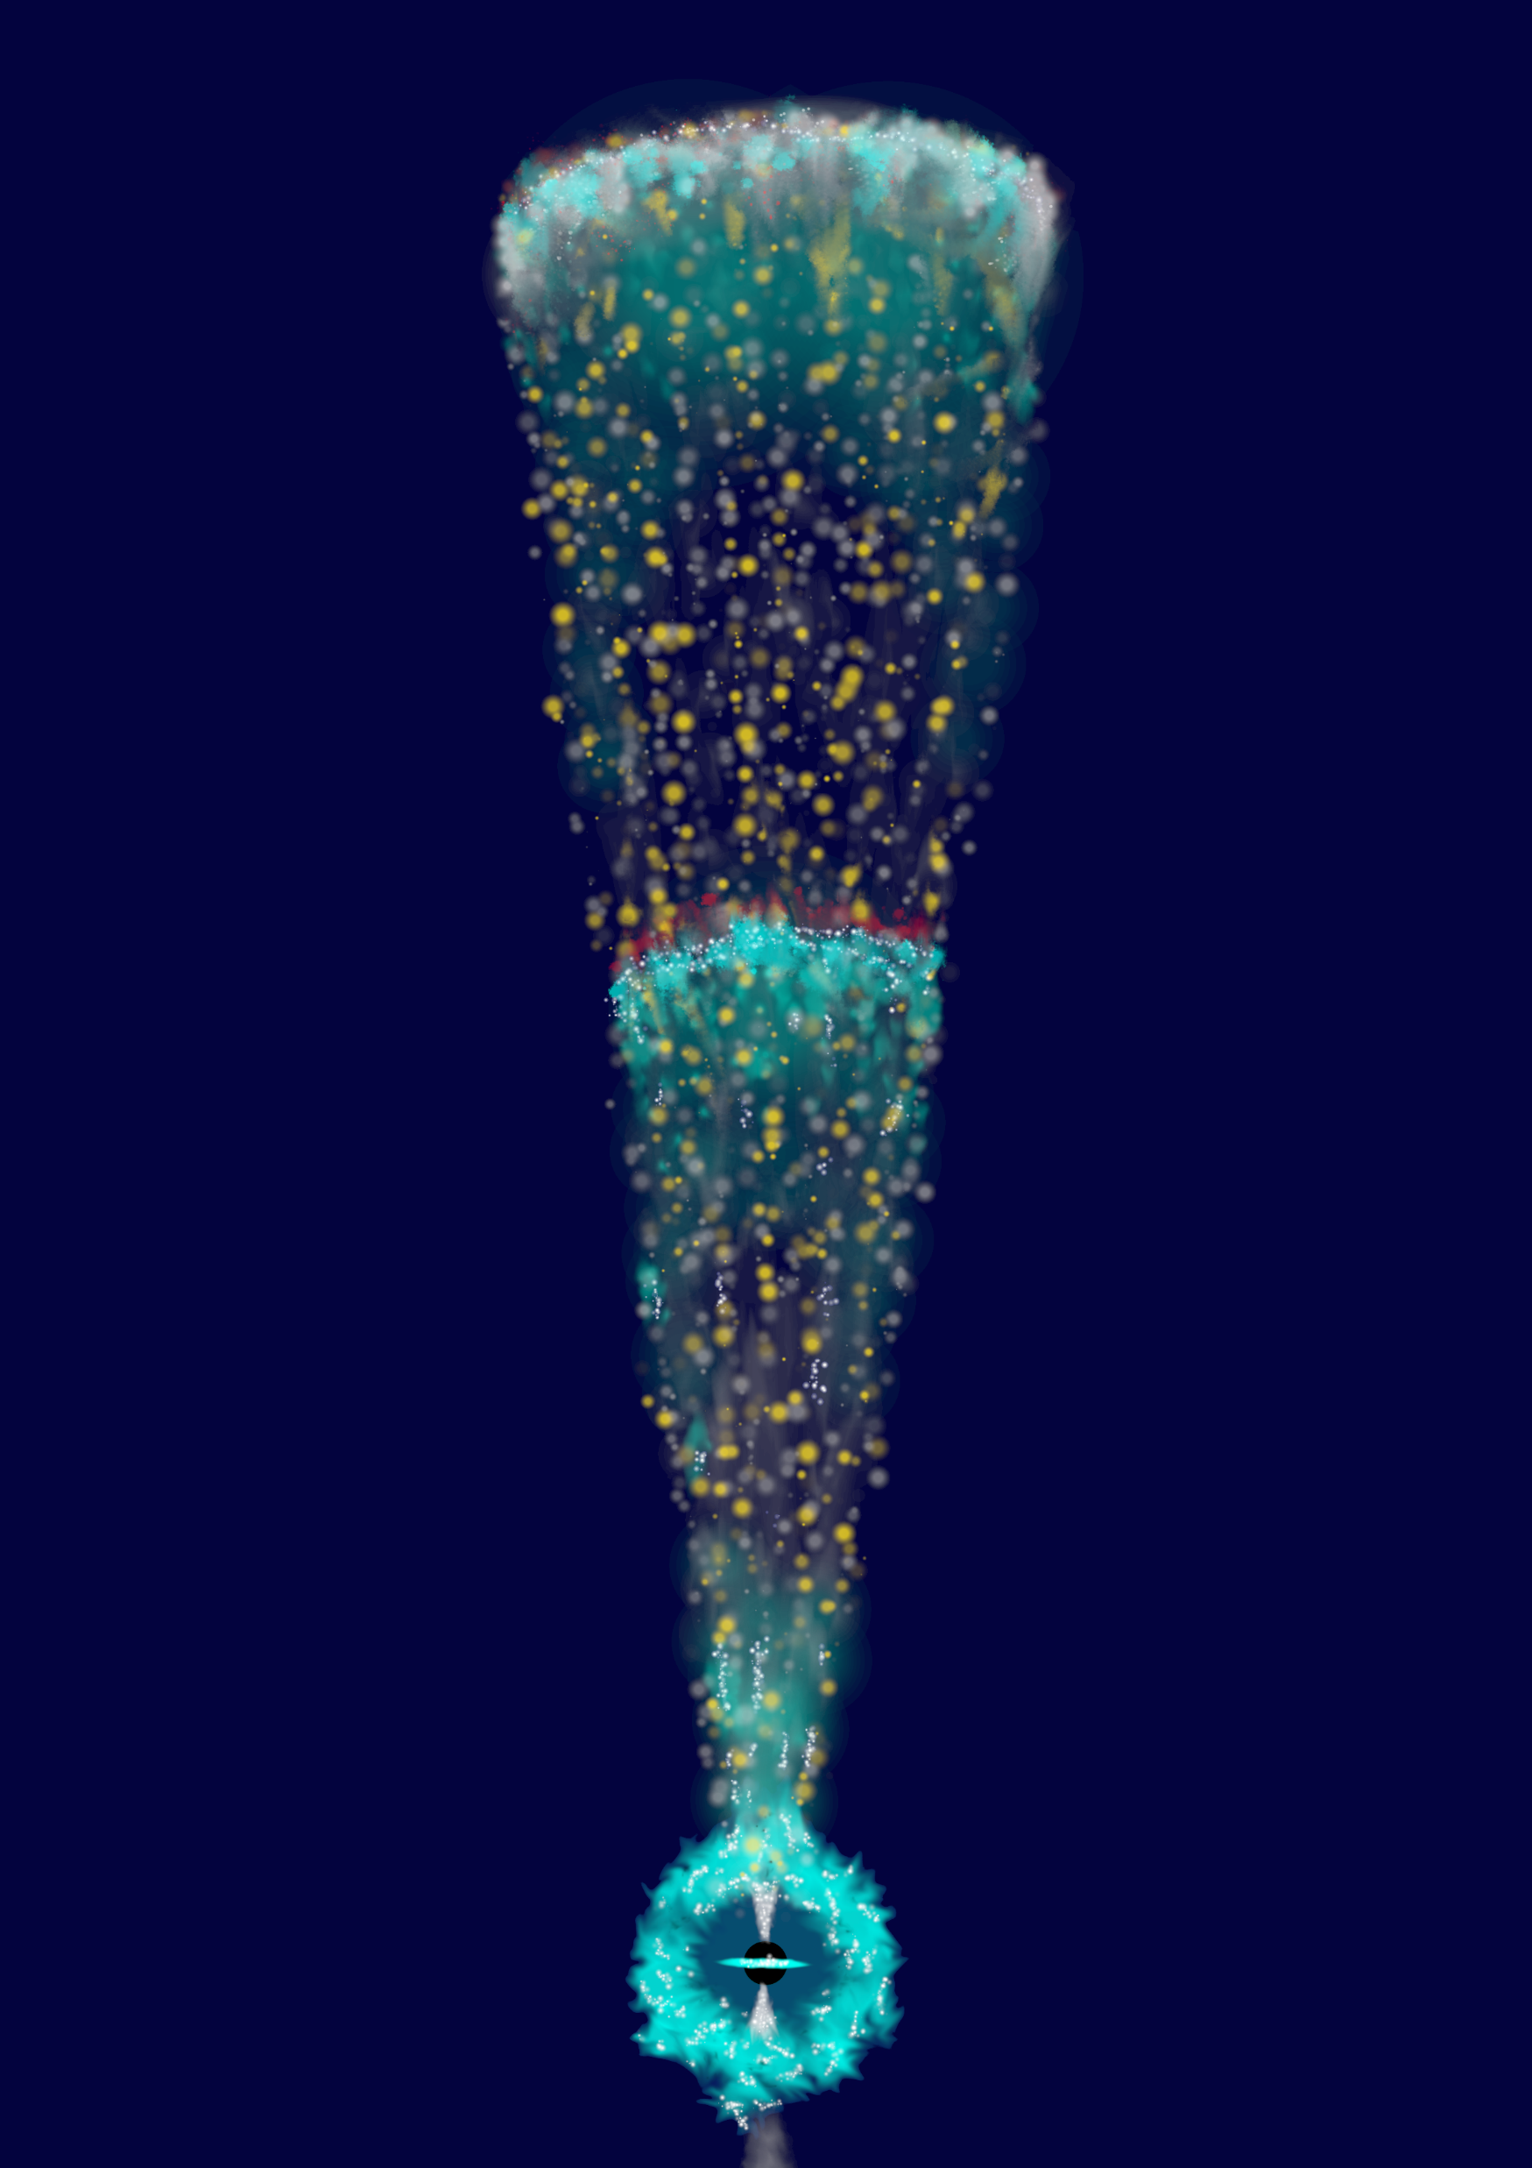
Outline
GRBs:
Introducing the Dainotti 3D relation
The richness of GRBs classes
Selection bias and redshift evolution
Circularity problem
Cosmological analysis
QSOs:
Introducing the Risaliti-Lusso relations
Selection bias and redshift evolution
Cosmological analysis
Comparison with the literature
GRB artistic vision, own work

Slide 4
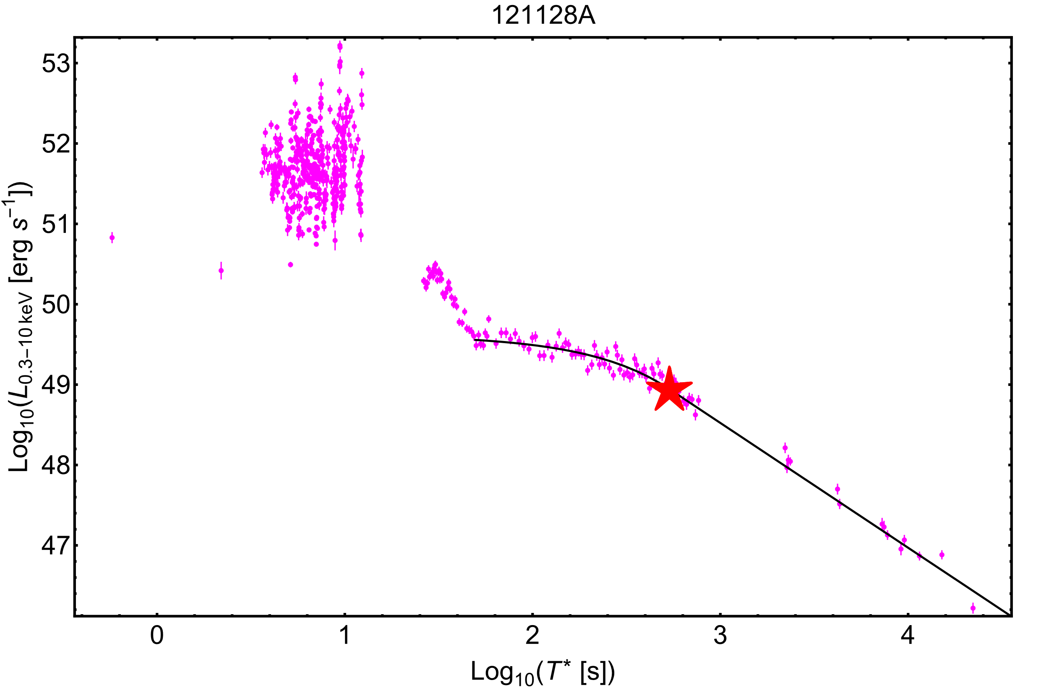
Dainotti 3D relation
$\log_{10}\left(L_{X}\right)=a×\log_{10}\left(T_{X}^{∗}\right)$ + b $×\log_{10}\left(L_{peak}\right)$ + c
1 sec peak luminosity in 15-150 keV
$$L=F×4πd_{L}^{2}(z)×K(p,z)$$
F – flux
$d_{L}$ - luminosity distance
K – „K correction”
p – spectral index
$$\left\{\begin{aligned}L\left(t\right)=L_{X}e^{α\left(1−\frac{t}{T_{X}}\right)}, t<T_{X} \\ L\left(t\right)=L_{X}{\left(\frac{t}{T_{X}}\right)}^{−α}, t≥T_{X}\end{aligned}\right.$$
Own work, Swift data

Slide 5
The GRB ZOO
GRBs
~500 observed by Swift with plateau
~50% with redshift
Long
With SNe Ib/c
Ultra Long?
Short
With KNe
Internal plateau?
XRFs
Without SNe
Without KNe
With Extended Emission
For full review see Dainotti et al.(2020)

Slide 6
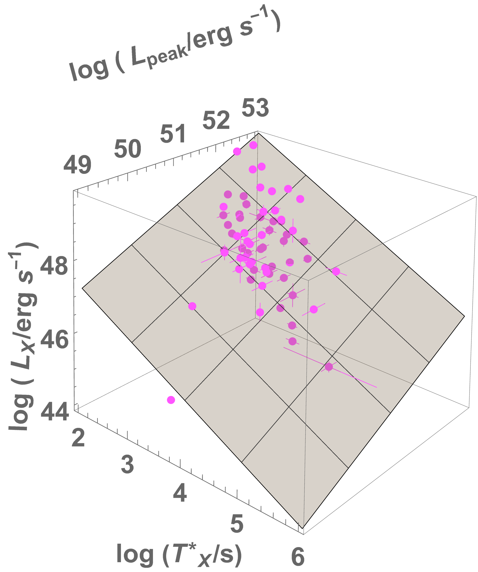
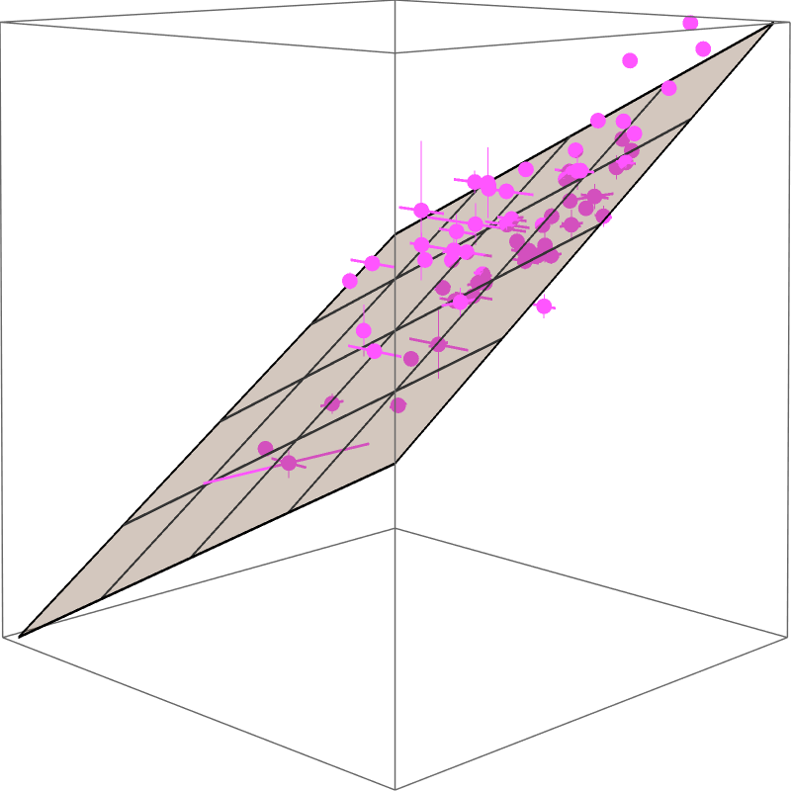
The Platinum Sample
Morphological features:
Long GRBs
Flat plateu
No bumps or flares
Data quality:
At least 5 points at the beginning of the plateau
No short plateau (<500s) with gaps after
64 sources
Intrinsic scatter: 0.34±0.04
$$\log_{10}\left(L_{X}\right)=\left(−0.86±0.13\right)×\log_{10}\left(T_{X}^{∗}\right)+\left(0.56±0.12\right)×\log_{10}\left(L_{peak}\right)+(21.8±6.3)$$
Own work

Slide 7
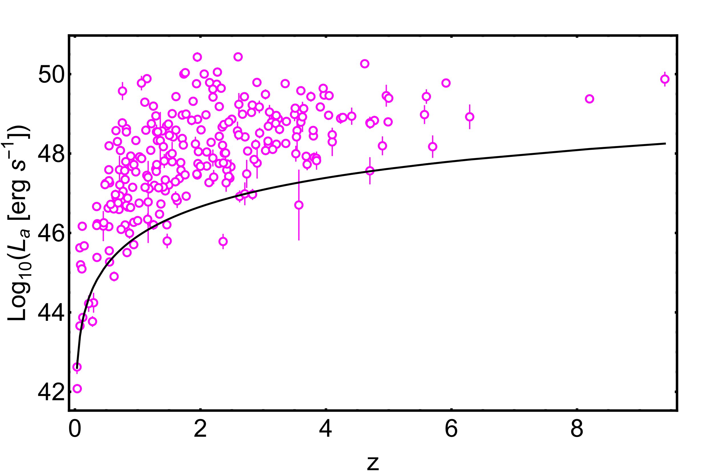
Selection bias
Own work

Slide 8
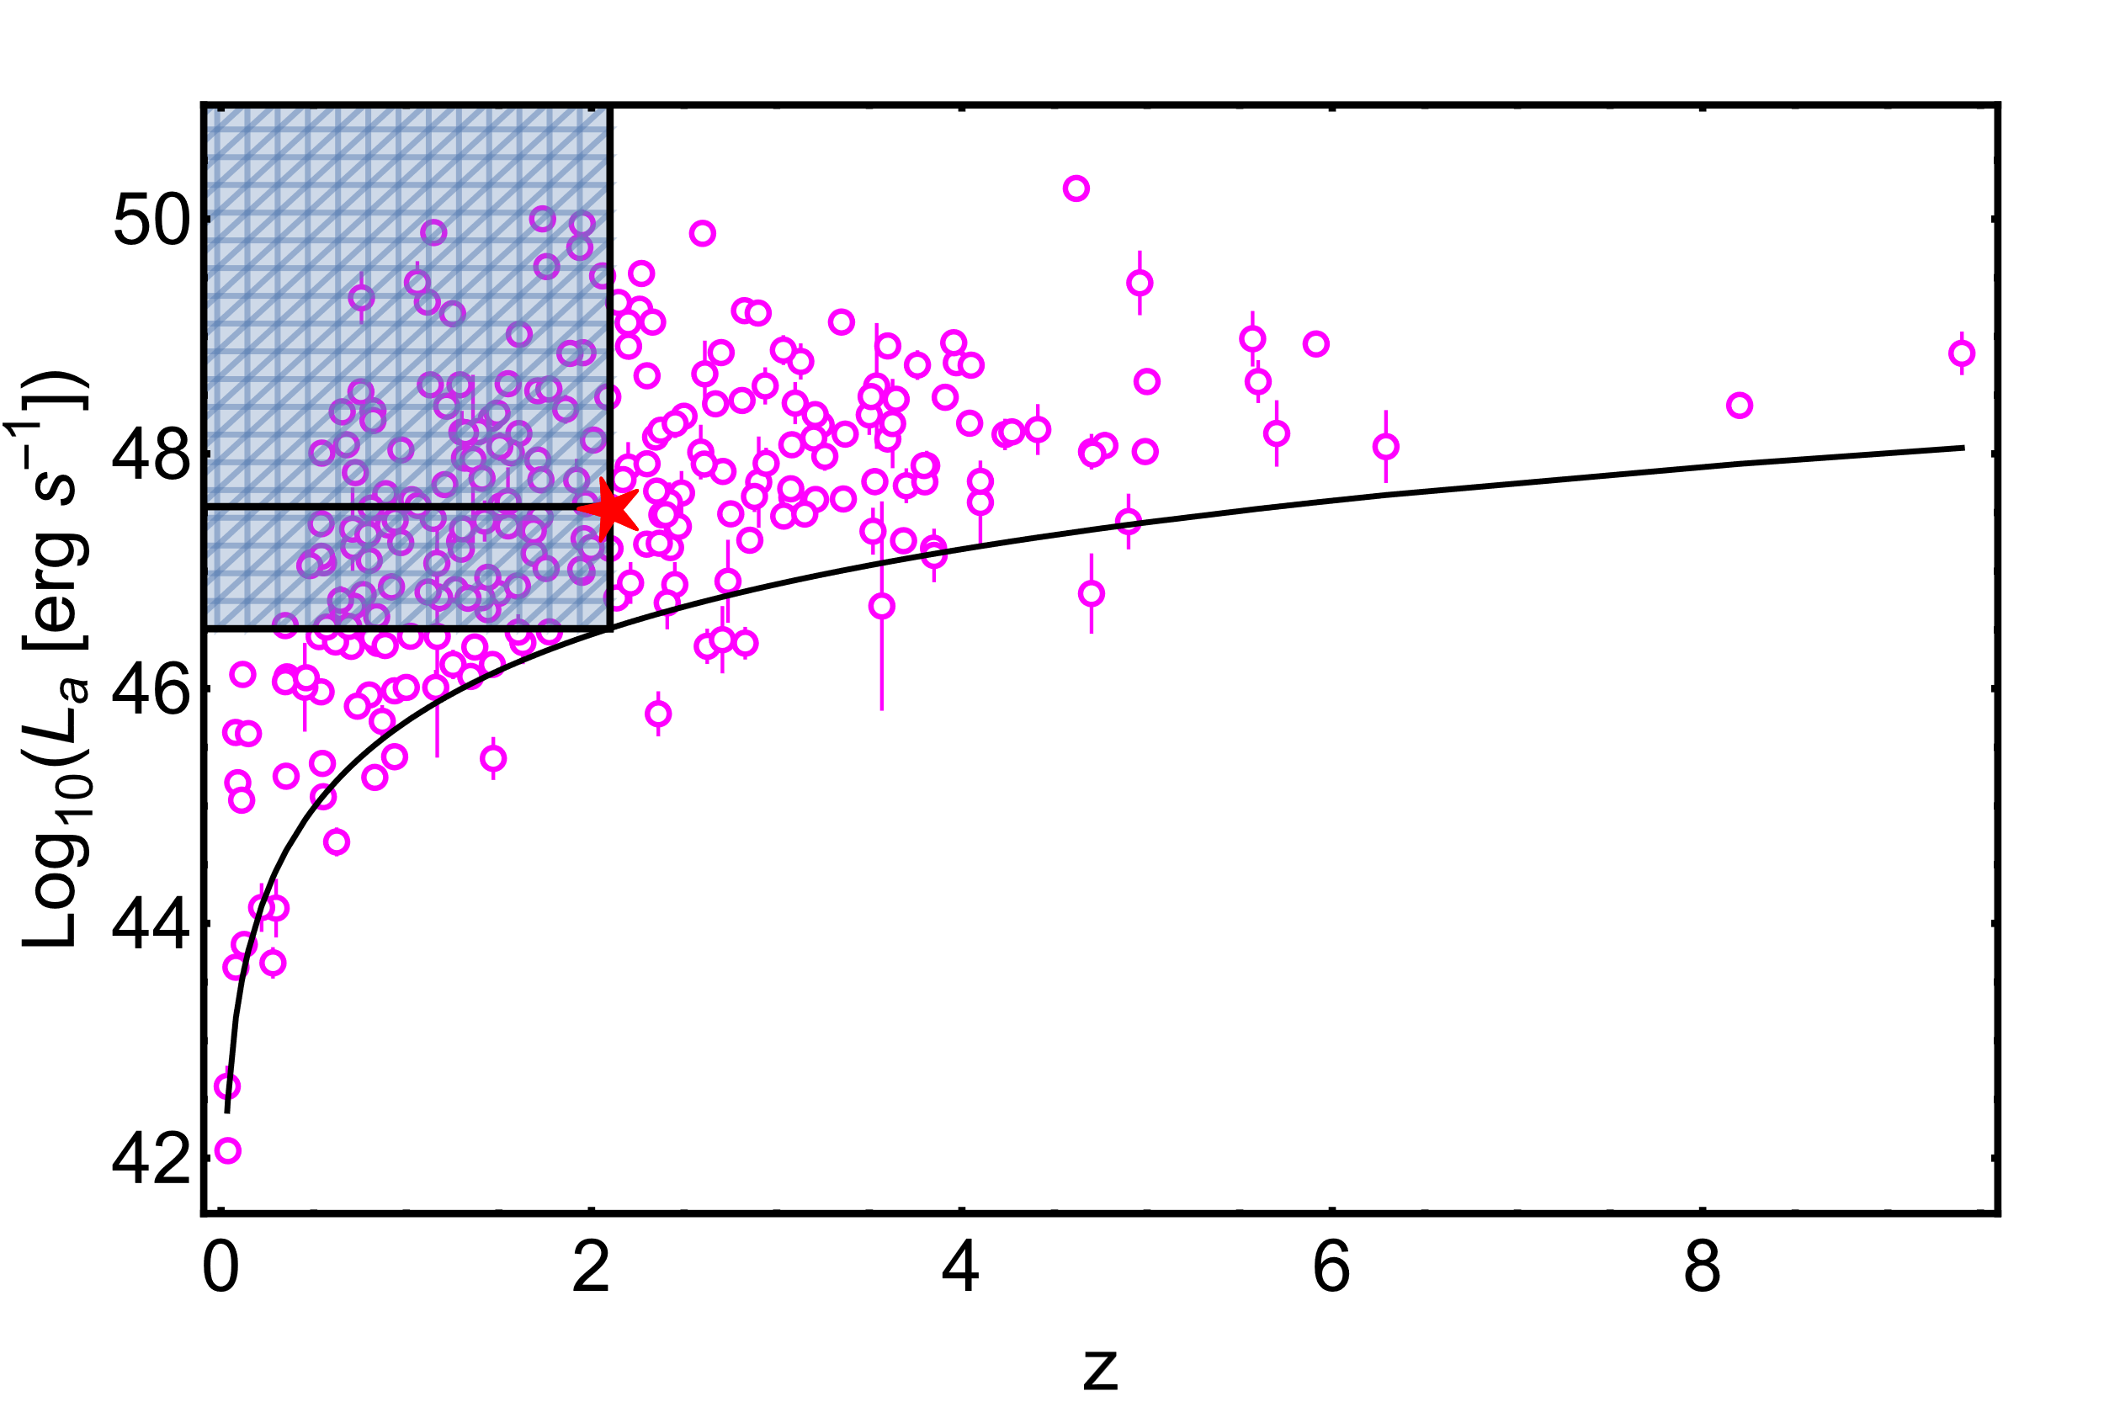
Efron&Petrosian (1996) method
$$τ=\frac{\sum_{i}^{N}{R_{i}−\frac{N_{i}+1}{2}}}{\sqrt{\sum_{i}^{N}{\frac{N_{i}^{2}+1}{12}}}}$$
$R_{i}$ - rang
$N_{i}$- numer of sources in associated set for i-point
τ is an analogue of the Kendall’s τ. For τ=0 there is no evolution.
We assume that the distribution of luminosity can be described by multiplication of two functions, one of them models the evolution. Thus we can detransform evolution:
$$L^{′}=L/g(z)$$
Own work

Slide 9
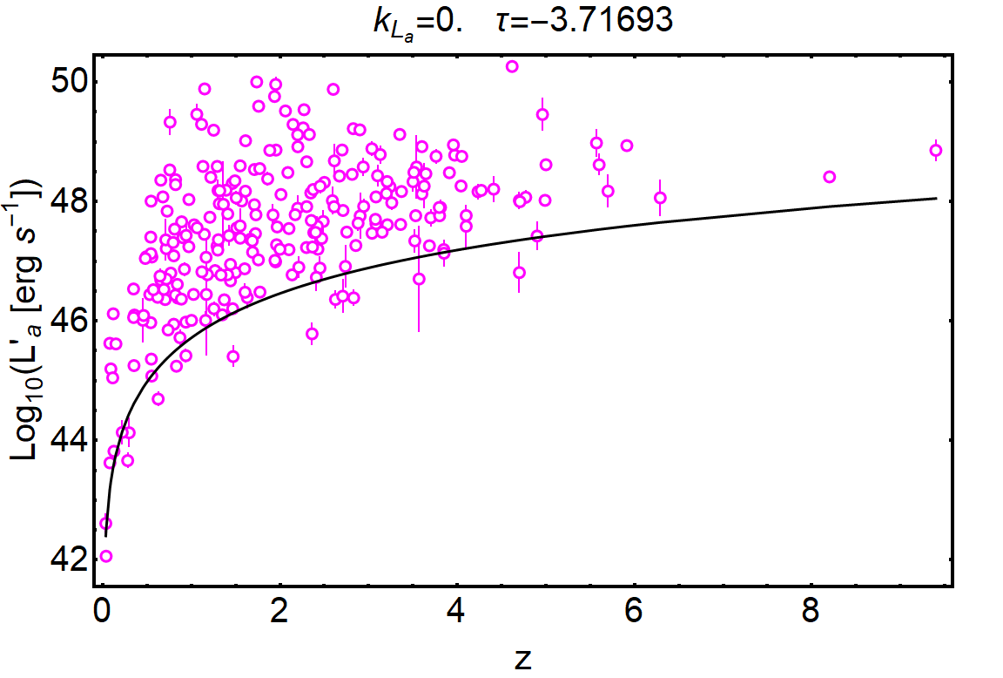
$$L^{′}=L/{(1+z)}^{k}$$
Assumed functional form of the evolution
Own work

Slide 10
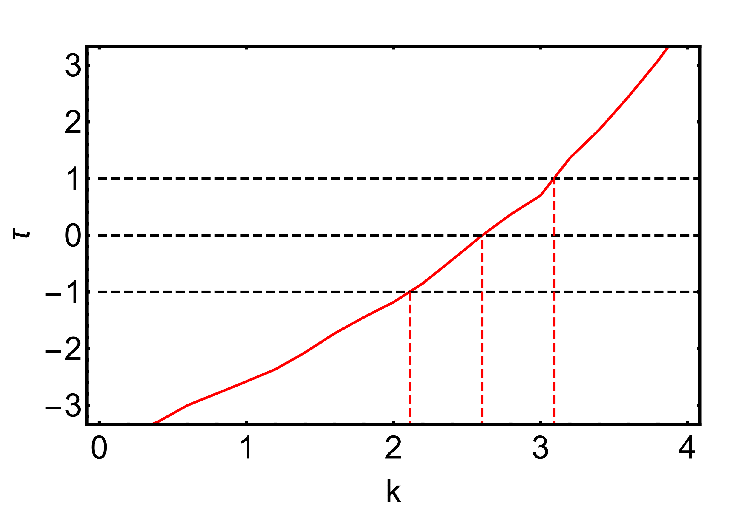
$$k_{L_{a}}=2.60±0.49$$
$$k_{L_{peak}}=2.50±0.29$$
$$k_{T_{a}}=−1.00±0.22$$
Own work

Slide 11
$$σ_{int}=0.34±0.04$$
$$σ_{int}=0.22±0.10$$
Figure from Dainotti et al.(2023)

Slide 12
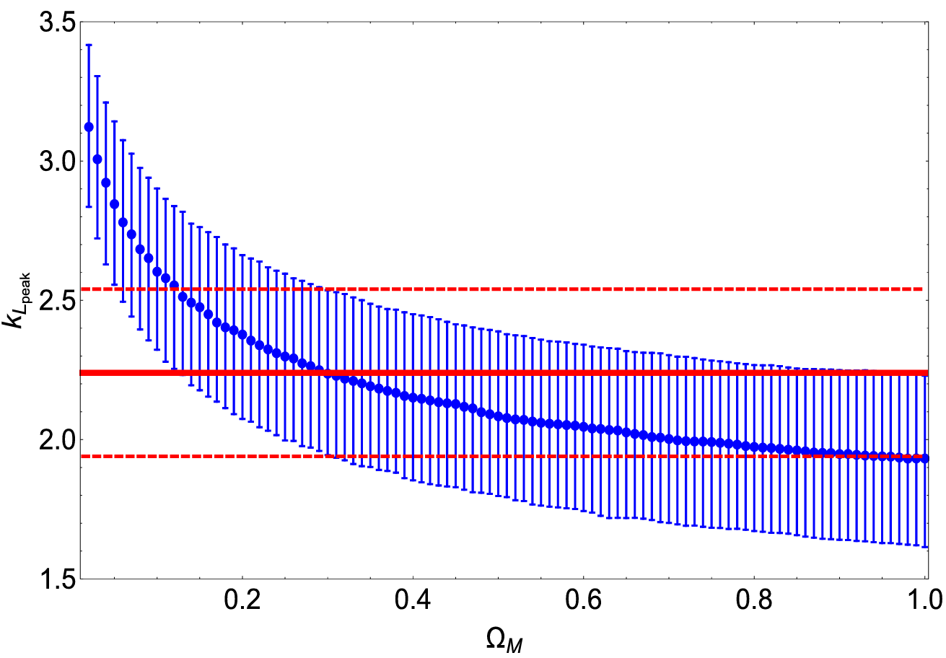
Circularity problem
Cosmological parameters
Distance
Luminosity
Correction for selection bias
Correlation
Figure from Dainotti et al.(2023)

Slide 13
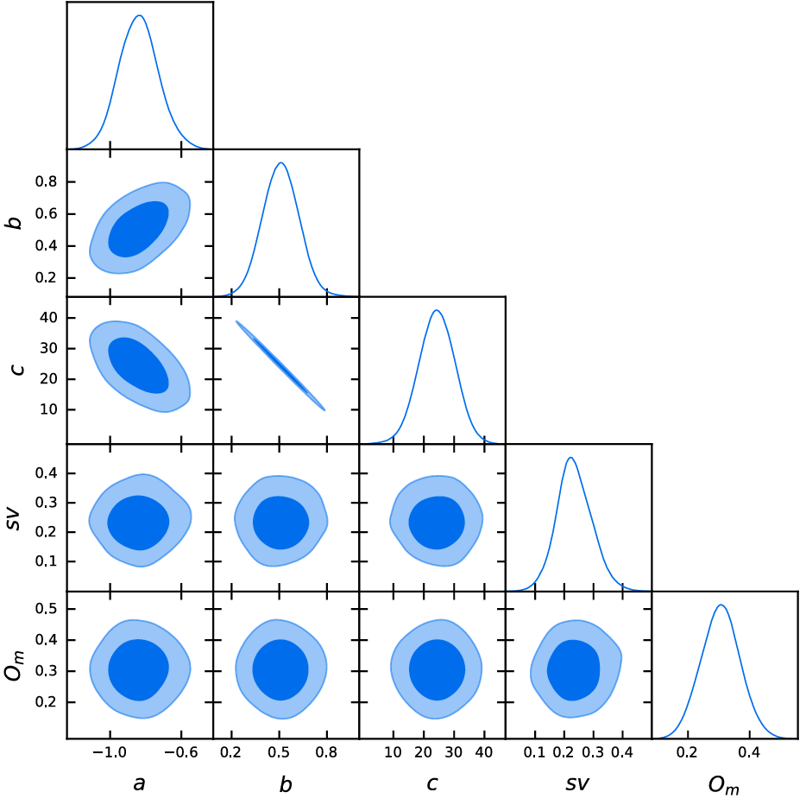
Cosmological analysis
GRBs alone
No calibration
gaussian priors
Evolution as a function of cosmology
← Always compatible with ΛCDM of SNe
Figure from Dainotti et al.(2023)

Slide 14
Addition of other probes
Table from Dainotti et al.(2023)
SNe Ia + QSOs EV -0.250 ± 0.134 1.87

Slide 15
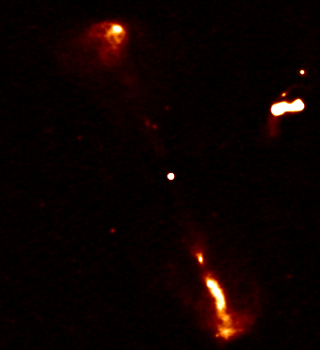
QSOs
Elias N1, LOFAR data, Own work

Slide 16
The Risaliti&Lusso relation
X-UV relations(X: 2 KeV, UV: 2500 Å):
$$\log_{10}\left(L_{X}\right)= γ×\log_{10}\left(L_{UV}\right)+β$$
$γ\sim 0.6, δ\sim 0.35 /0.40 dex$ from the literature (Lusso et al. 2010)
δ has mainly an observational origin and is not an intrinsic dispersion
→ possible cosmological application through sample selection to remove dust reddening, host-galaxy contamination, X-ray absorption and Eddington bias
Cleaned sample: 2421 sources in z = 0.009 − 7.54, δ ∼ 0.2 dex (Lusso et al. 2020)

Slide 17
Redshift evolution
Figure from Lenart et al.(2023)

Slide 18
Circularity problem
Figure from Lenart et al.(2023)

Slide 19
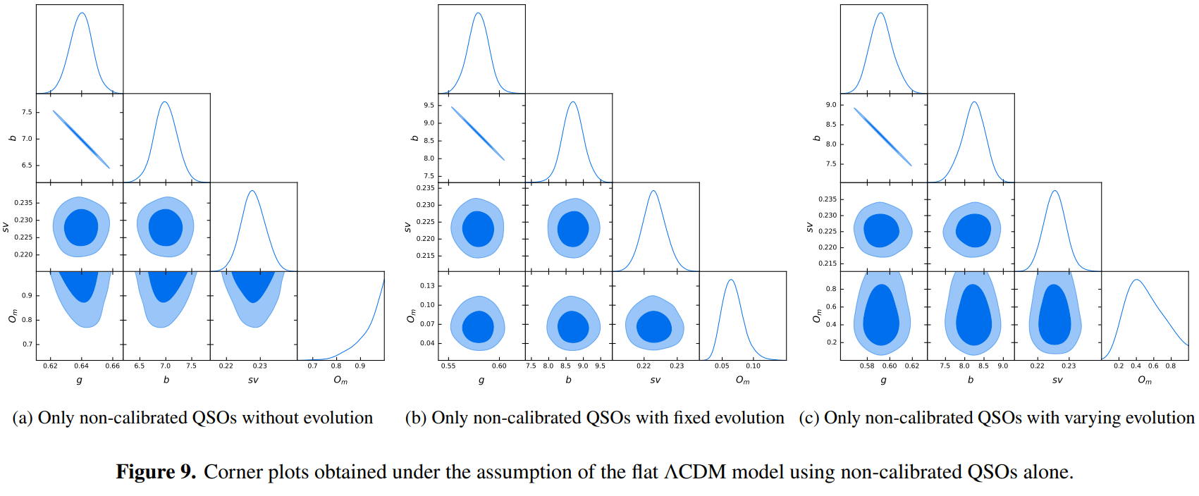
Cosmological results
Confirmed with Copula method by Wang e al.(2022)
Figure from Lenart et al.(2023)

Slide 20
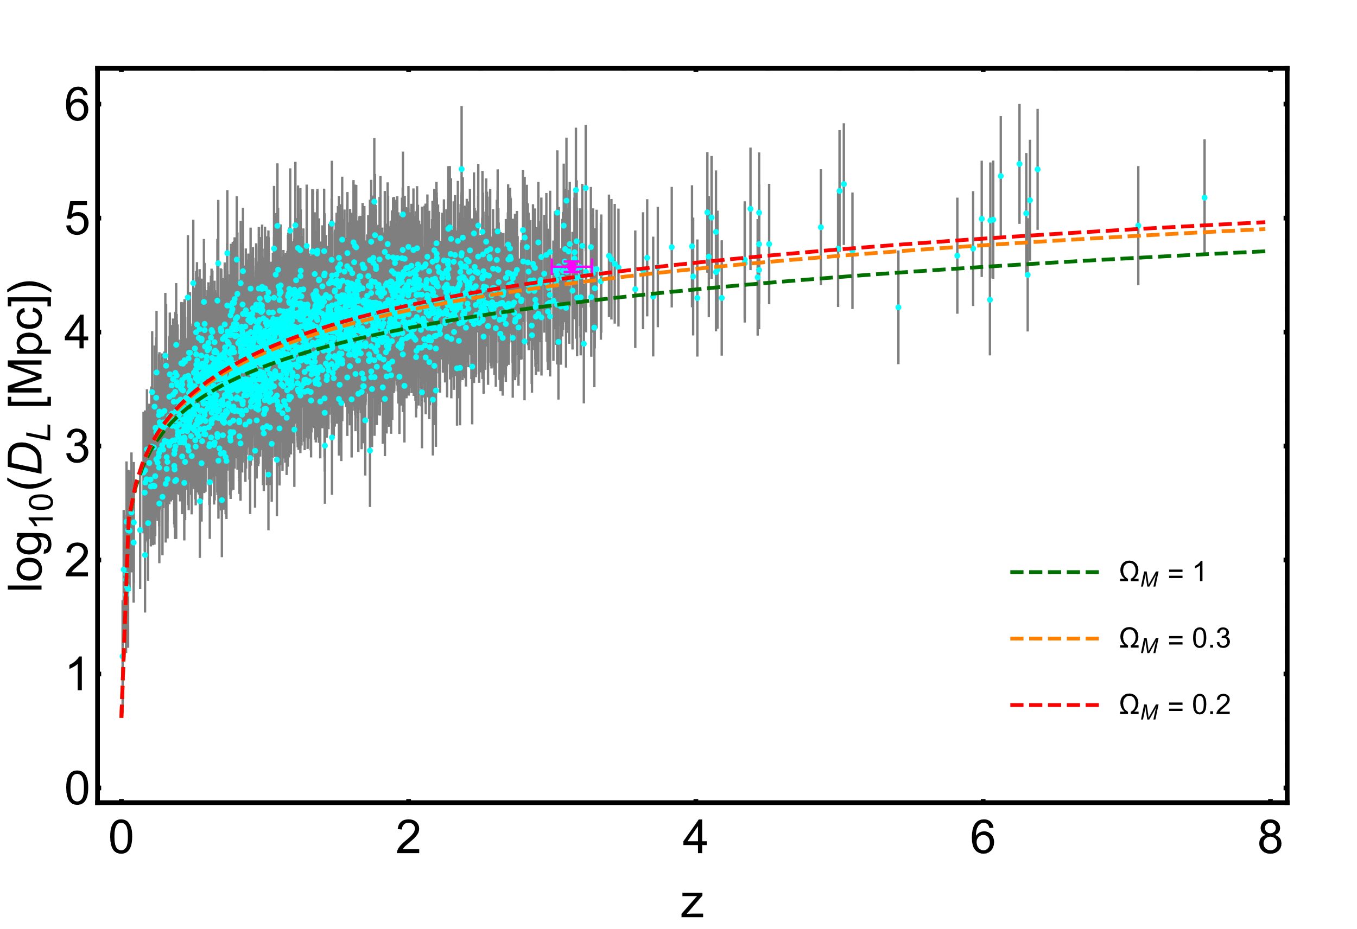
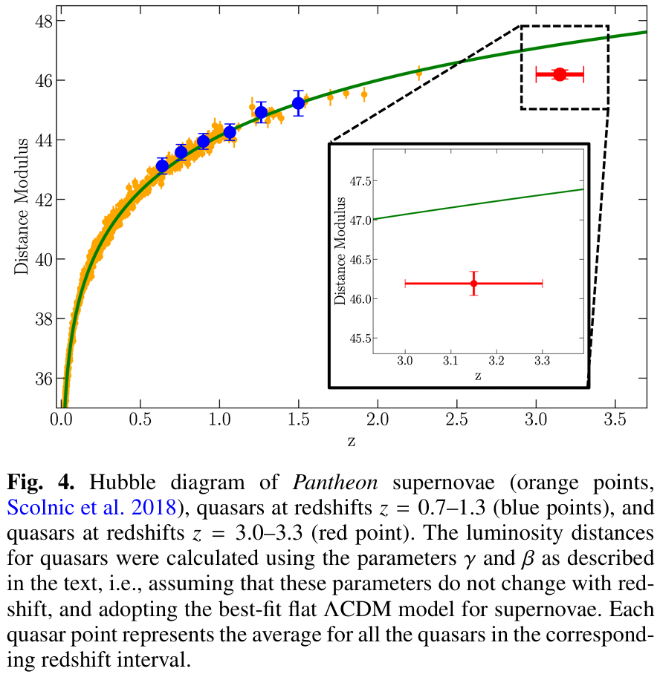
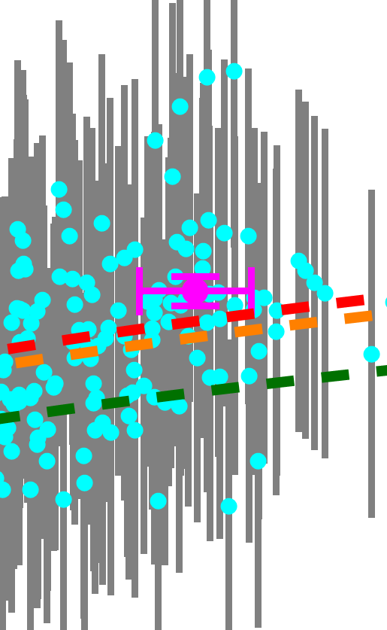
Our results with correction for evolution show a completely different behaviour. For most of high z sources ΛCDM underestimates distance. Similar observations are presented in Wang et al.(2022)
Few of results of Zhang et al.(2024) with calibration point towards smaller $Ω_{M}$
Sacchi et al.(2022) claims a 4σ tension with LCDM

Slide 21
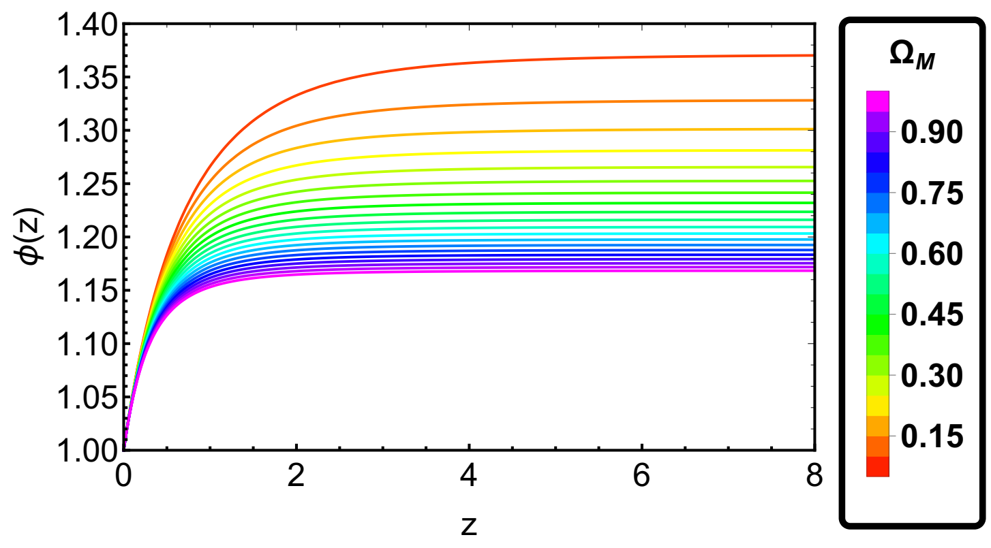
$Ω_{M}$ would be slightly smaller…
There exists a model with such a prediction
The metric f(R) gravity model in a Jordan frame applied in a flat Robertson-Walker geometry with a matter component.
Figure from Dainotti et al.(2024)
$$H^{2}=\frac{1}{φ}\left(\frac{κ^{2}}{3}ρ_{m}−H\dot{φ}+\frac{V(φ)}{6}\right)$$
$$R≡\frac{dV}{dφ}=6\dot{H}+12H^{2}$$
$$d_{L}=(1+z)\frac{c}{H_{0}}\int_{0}^{z}{\frac{dζ}{\sqrt{\frac{Ω_{M}}{φ(ζ)}{\left(1+ζ\right)}^{3}+(1−Ω_{M})}}}$$

Slide 22
Bibliography
The full presentation is available at the indico website
Dainotti, M.G., Lenart, A.Ł., Sarracino, G., Nagataki, S., Capozziello, S., and Fraija, N.: 2020, The Astrophysical Journal 904, 97. doi:10.3847/1538-4357/abbe8a
Dainotti, M.G., Lenart, A.Ł., Chraya, A., Sarracino, G., Nagataki, S., Fraija, N., and, ...: 2023, Monthly Notices of the Royal Astronomical Society 518, 2201. doi:10.1093/mnras/stac2752
Lusso, E., Risaliti, G., Nardini, E., Bargiacchi, G., Benetti, M., Bisogni, S., and, ...: 2020, Astronomy and Astrophysics 642, A150. doi:10.1051/0004-6361/202038899
Dainotti, M.G., Bargiacchi, G., Lenart, A.Ł., Capozziello, S., 'O Colg'ain, E., Solomon, R., and, ...: 2022, The Astrophysical Journal 931, 106. doi:10.3847/1538-4357/ac6593
Lenart, A.Ł., Bargiacchi, G., Dainotti, M.G., Nagataki, S., and Capozziello, S.: 2023, The Astrophysical Journal Supplement Series 264, 46. doi:10.3847/1538-4365/aca404
Dainotti, M.G., Lenart, A.Ł., Yengejeh, M.G., Chakraborty, S., Fraija, N., Di Valentino, E., and, ...: 2024, Physics of the Dark Universe 44, 101428. doi:10.1016/j.dark.2024.101428
Wang, B., Liu, Y., Yuan, Z., Liang, N., Yu, H., and Wu, P.: 2022, The Astrophysical Journal 940, 174. doi:10.3847/1538-4357/ac9df8
Zhang, H., Liu, Y., Yu, H., Nong, X., Liang, N., and Wu, P.: 2024, Monthly Notices of the Royal Astronomical Society 530, 4493. doi:10.1093/mnras/stae1120
De Felice, A., Tsujikawa, S. f(R) Theories. Living Rev. Relativ. 13, 3 (2010). https://doi.org/10.12942/lrr-2010-3
Montani G., De Angelis M., Bombacigno F., Carlevaro N., 2024, MNRAS, 527, L156. doi:10.1093/mnrasl/slad159
Di Valentino, E., Anchordoqui, L.A., Akarsu, "O., Ali-Haimoud, Y., Amendola, L., Arendse, N., and, ...: 2021, Astroparticle Physics 131, 102604. doi:10.1016/j.astropartphys.2021.102604
The code for correction for evolution is public: Selection biases and redshift evolution in relation to cosmology | The Notebook Archive

Slide 23
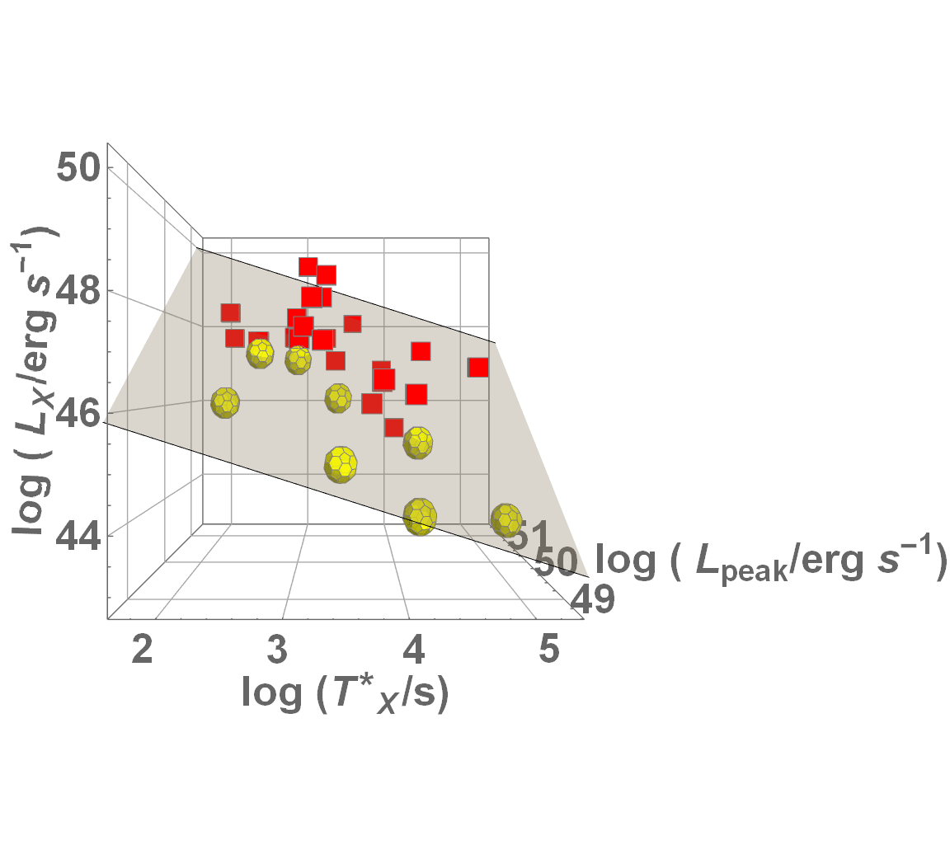
In Future Maybe Also Kilonovae…
$$σ_{int}=0.21±0.16$$
Own work

