Slide 1
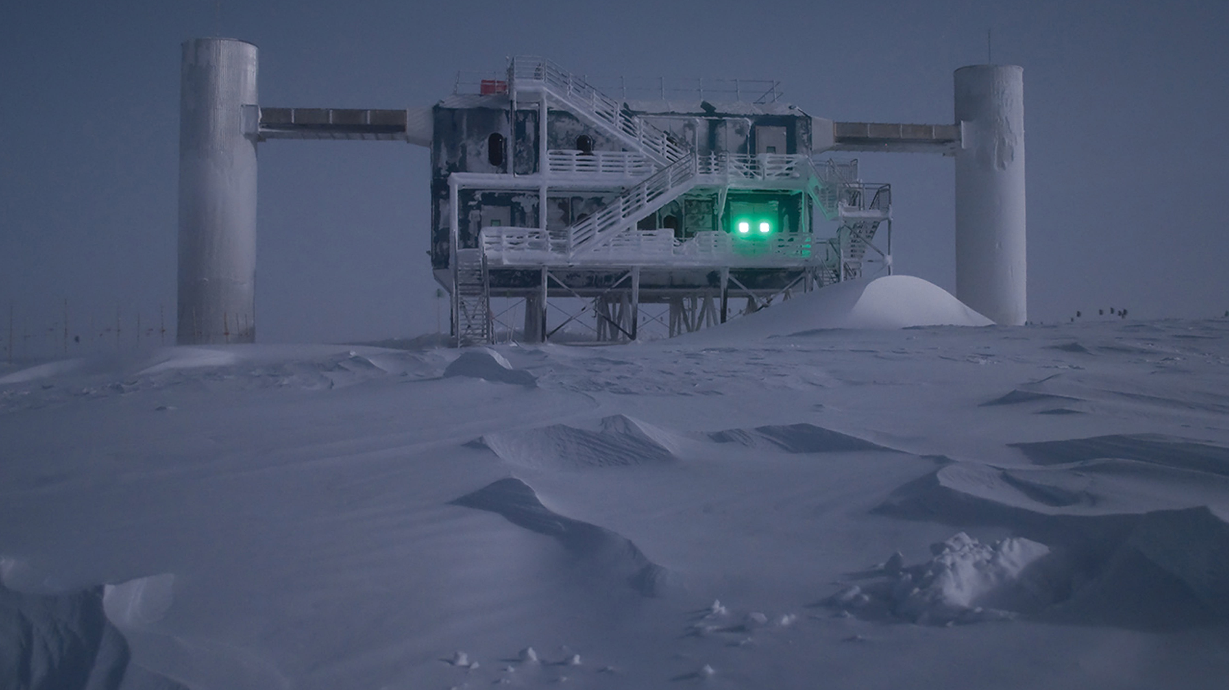
Reconstructions in IceCube
Christian Haack (ECAP FAU Erlangen-Nürnberg) for the IceCube Collaboration
II EU Workshop on Water Cherenkov Experiments for Precision Physics

Slide 2
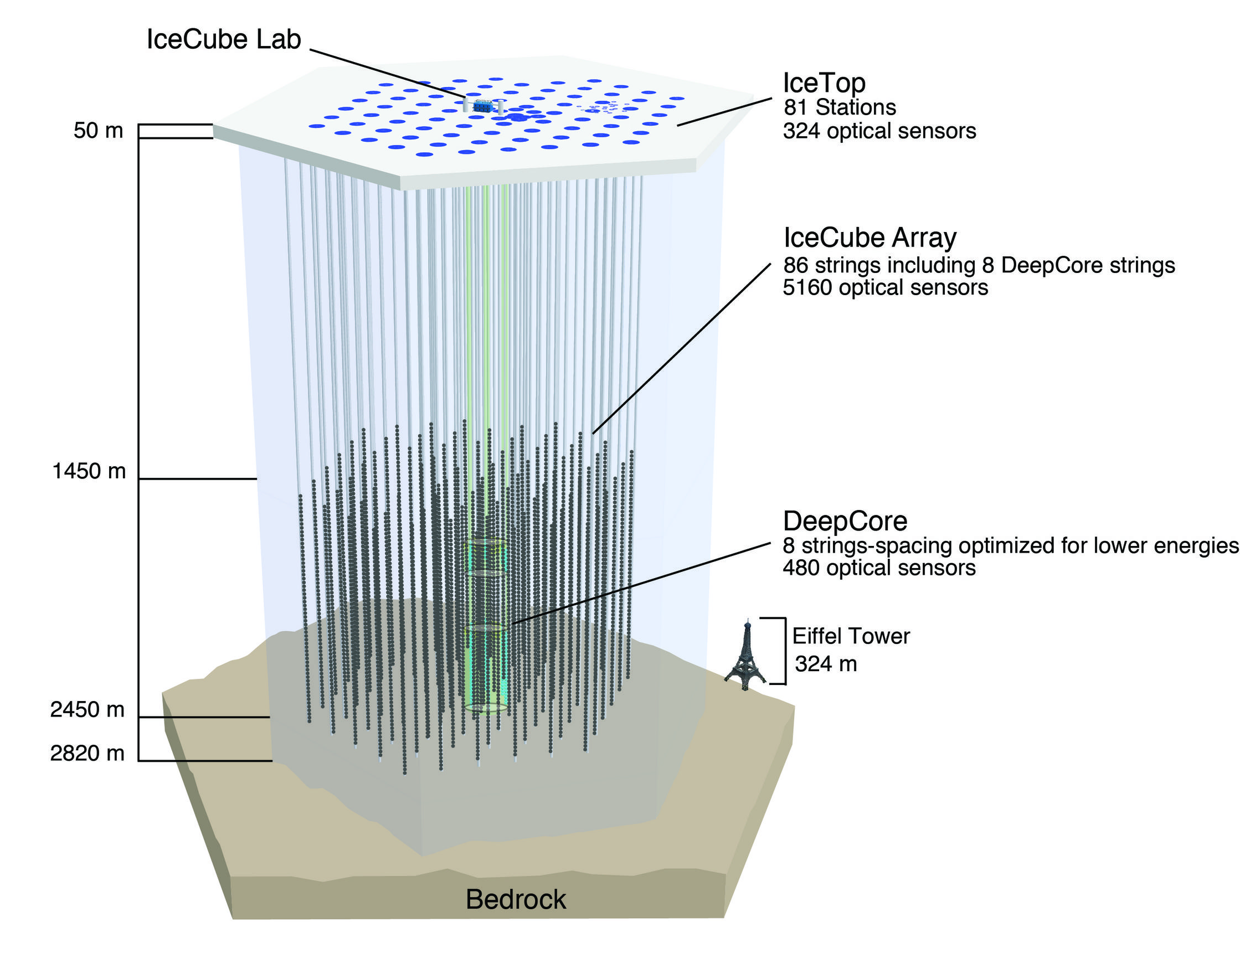

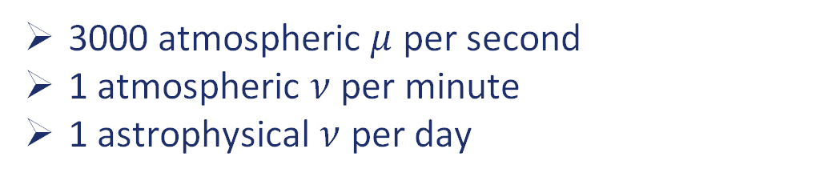



The IceCube Neutrino Observatory
$$μ$$
86 Strings with 60 Digital Optical Modules (DOMs)
Full configuration running with > 99% uptime since 2011
$ν_{e}$
3000 atmospheric $μ$ per second
1 atmospheric $ν$ per minute
1 astrophysical $ν$ per day
$$μ$$
$$ν_{μ}$$

Slide 3






Neutrino Interactions in Ice
$$ν_{l}$$
$$l$$
Cherenkov Light
N
CC Deep Inelastic Scattering
$$ν_{l}+X→l+X′$$
Hadronic Cascade
$$ν_{l}$$
$$ν_{l}$$
Cherenkov Light
NC Deep Inelastic Scattering
N
$$ν_{l}+X→ν_{l}+X′$$
Hadronic Cascade

Slide 4
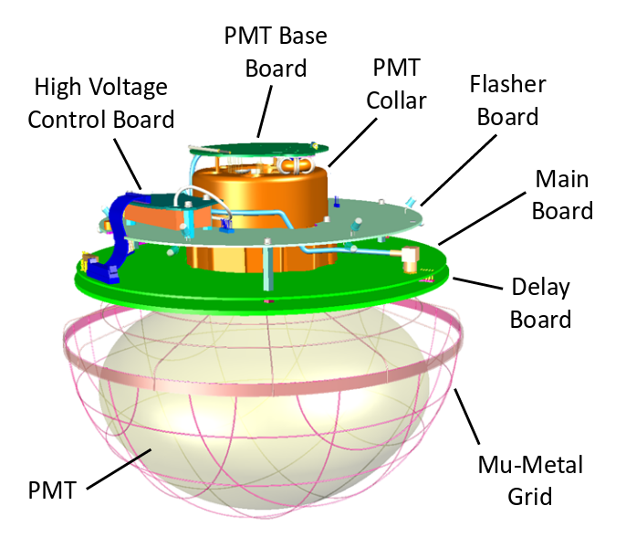


Modelling the Antarctic ice
Accurate reconstruction require a precise model of the optical properties of the Antarctic ice
Model consists of 10m thick layers of constant optical properties.
Parameters obtained by combining bore-hole stratigraphy with LED calibration data in a simulation based forward fit.
Includes effect of ice-layer undulations and ice birefrigence
Ice Layers
$$a_{i},b_{i}$$
$$a_{i+1},b_{i+1}$$
10m
https://doi.org/10.1016/j.nima.2012.11.170

Slide 5
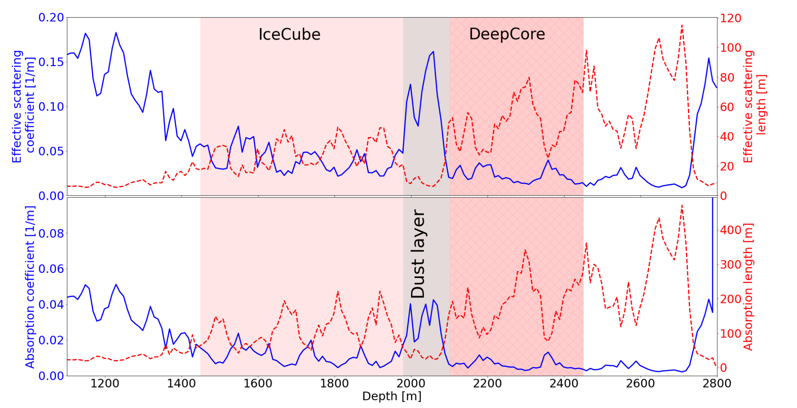
Modelling the Antarctic ice
https://doi.org/10.5194/tc-18-75-2024

Slide 6
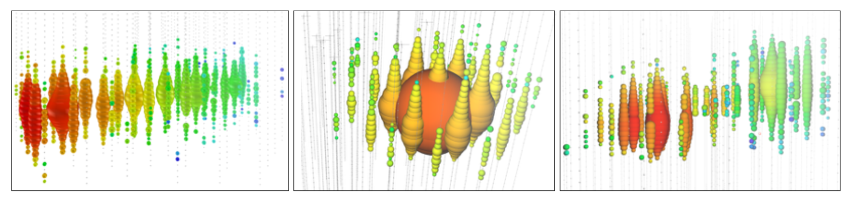





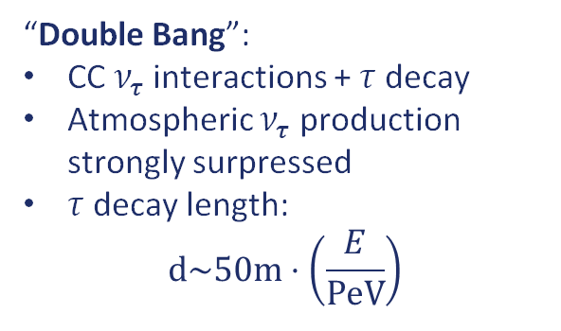



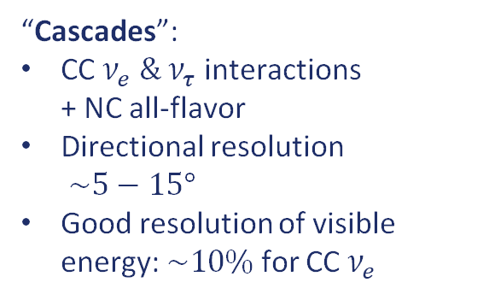



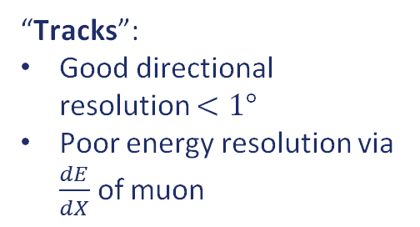
Neutrino signatures
$$ν$$
$$μ$$
$$τ$$
$$\frac{dE}{dX}$$
$$μ$$
or
$$τ$$
$$ν$$
$$e$$
arXiv:2008.04323v1
N
$$E_{vis}$$
d
$$ν_{τ}$$
$$e/X$$
“Tracks”:
Good directional resolution $<1°$
Poor energy resolution via $\frac{dE}{dX}$ of muon
“Cascades”:
CC $ν_{e} \& ν_{τ}$ interactions
+ NC all-flavor
Directional resolution
$\sim 5−15°$
Good resolution of visible energy: $\sim 10\%$ for CC $ν_{e}$
“Double Bang”:
CC $ν_{τ}$ interactions + $τ$ decay
Atmospheric $ν_{τ}$ production strongly surpressed
$τ$ decay length:
$d\sim 50m⋅\left(\frac{E}{PeV}\right)$

Slide 7
Neutrino signatures
$$ν$$
$$μ$$
$$τ$$
$$\frac{dE}{dX}$$
$$μ$$
or
$$τ$$
$$ν$$
$$e$$
arXiv:2008.04323v1
N
$$E_{vis}$$
d
$$ν_{τ}$$
$$e/X$$
In this talk:
Selected reconstructions for high-energy tracks & cascades
For low energy reconstructions, see: https://arxiv.org/abs/2203.02303

Slide 8
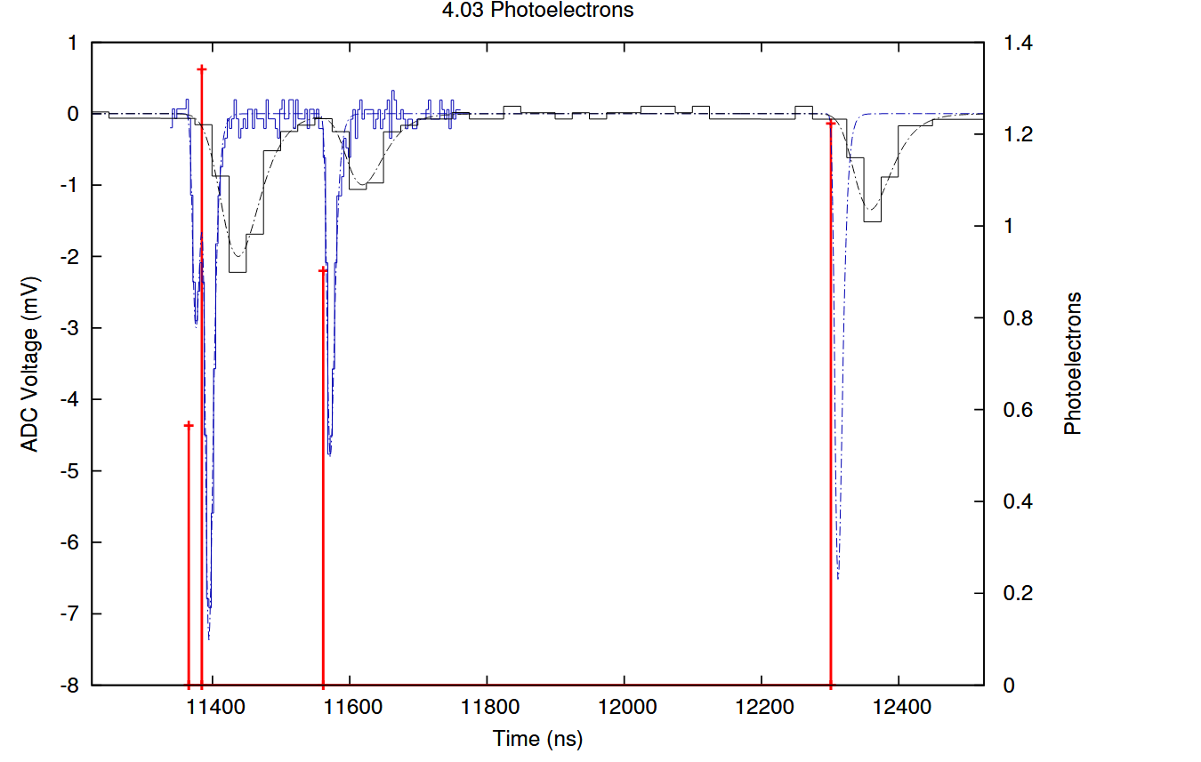
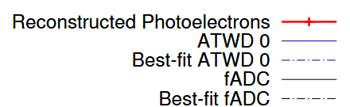

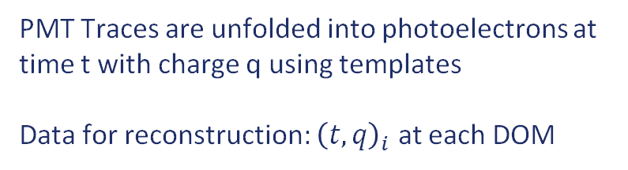
What does IceCube measure?
https://arxiv.org/pdf/1311.4767
PMT Traces are unfolded into photoelectrons at time t with charge q using templates
Data for reconstruction: ${\left(t, q\right)}_{i}$ at each DOM
$$μ$$

Slide 9
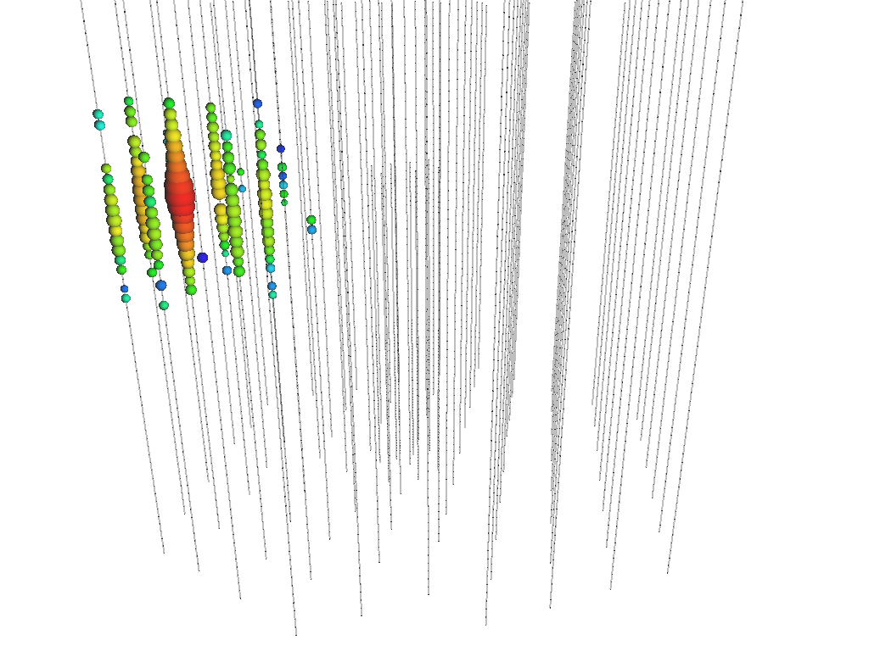
Reconstruction Goals & Challanges
How do we select & infer the properties of neutrinos from the number of detected photons and their arrival times?
In general, we cannot directly reconstruct neutrino properties.
=> Reconstruct properties of secondaries (energy, direction) and infer neutrino properties statistically in analysis
Precise model of the optical properties of the ice required
Large dynamic range: In the same event, we can have DOMs with single photon hits and saturated DOMs
=> Different algorithms for different energy ranges.

Slide 10
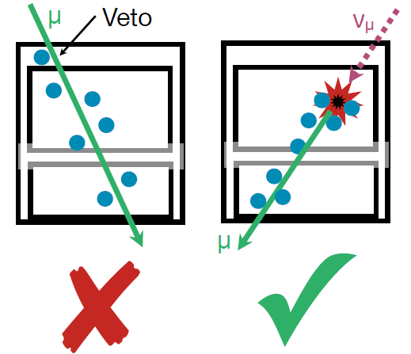
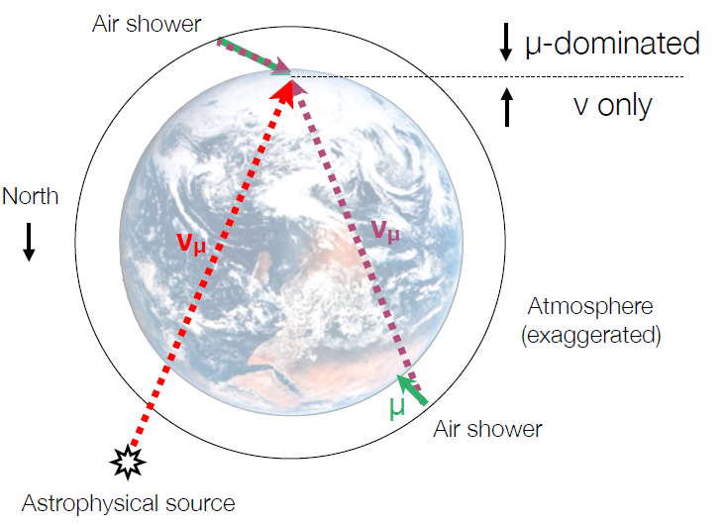
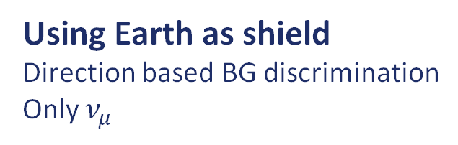
Event Selection Strategies
Fiducialisation
Morphology-based BG discrimination
All* flavors
Using Earth as shield
Direction based BG discrimination
Only $ν_{μ}$
Both techniques require
precise reconstructions!
“Starting Events”
“Upgoing Tracks”

Slide 11
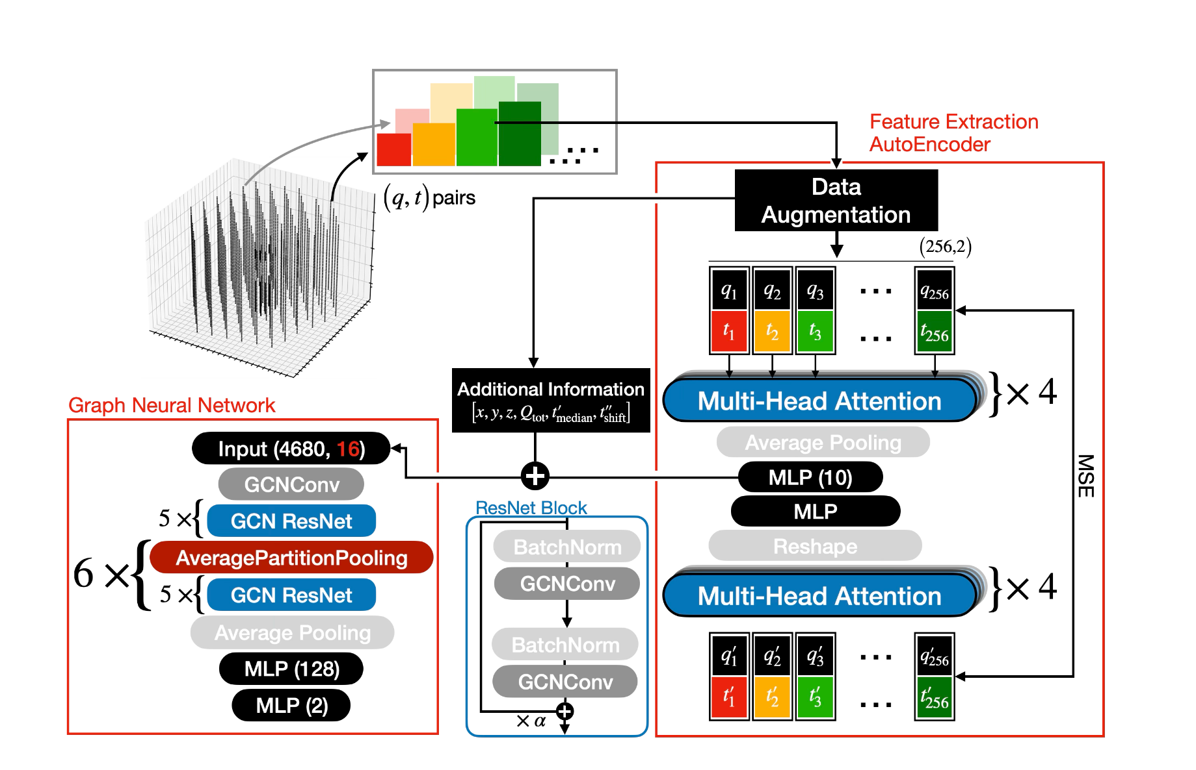
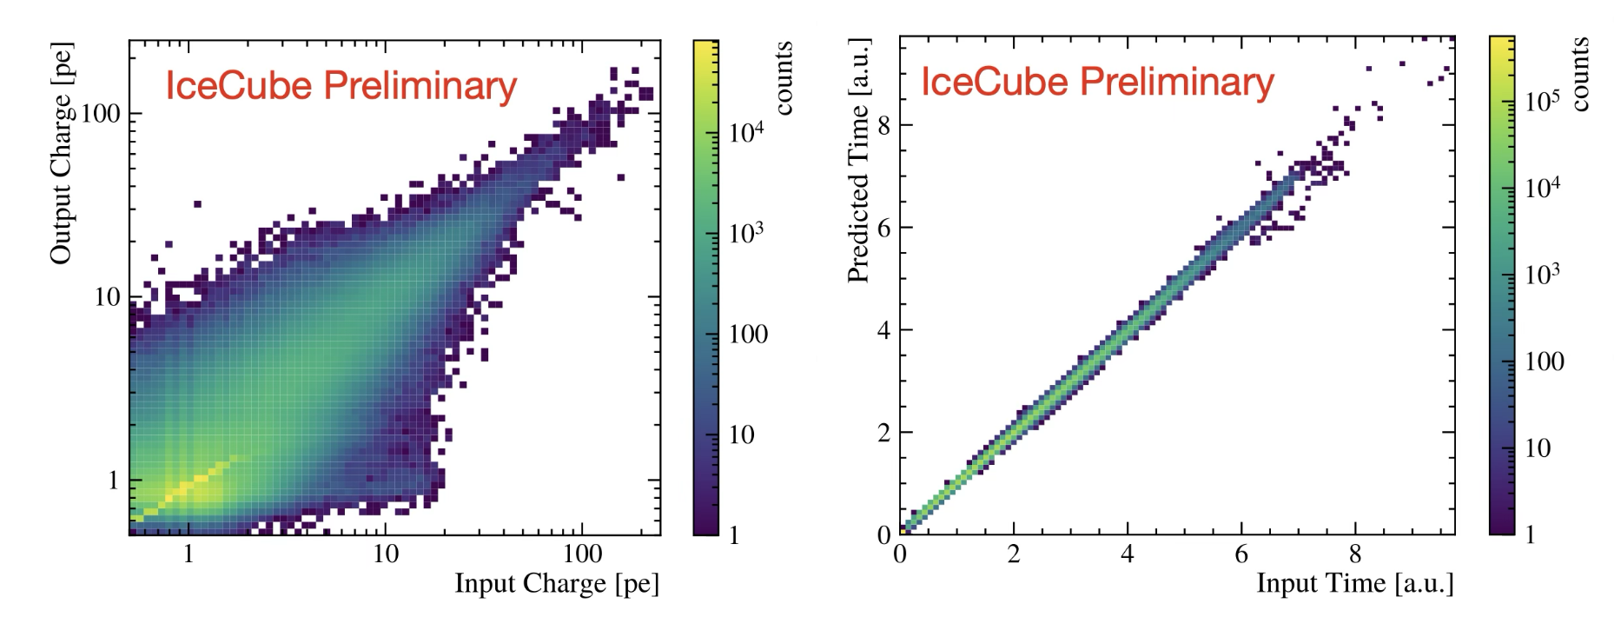
Muon Event Selection with Transformers
For muon neutrinos, atmospheric muon BG has to be reduced by ~10^7
New DNN architecture combines a transformer-based auto-encoder for extracting features from raw data with a Graph-Neural Network
Can be used for classification (event selection) and reconstruction (WIP)
https://arxiv.org/abs/2507.07452v1

Slide 12
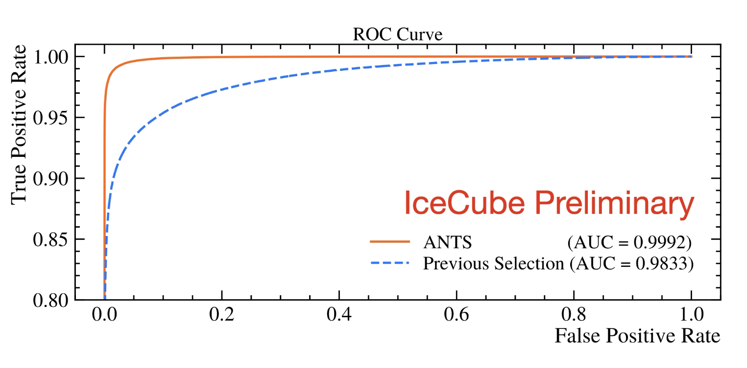
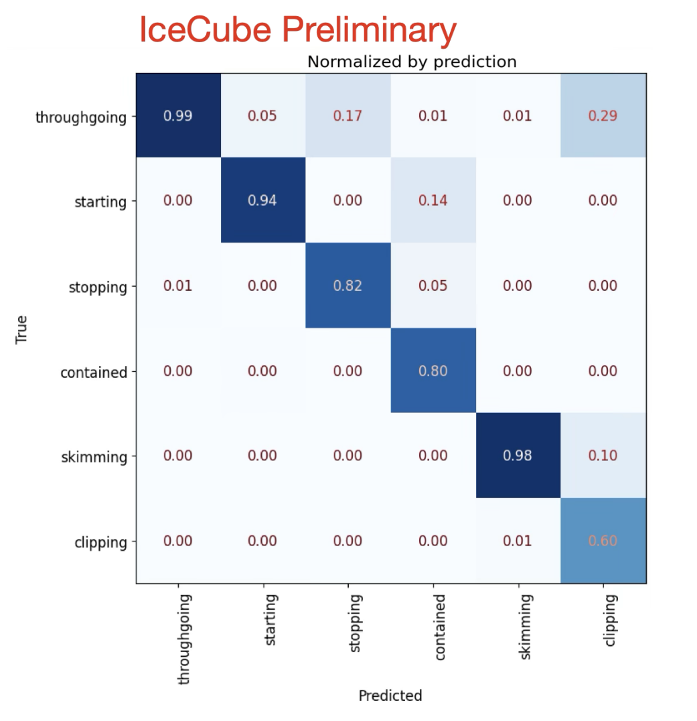
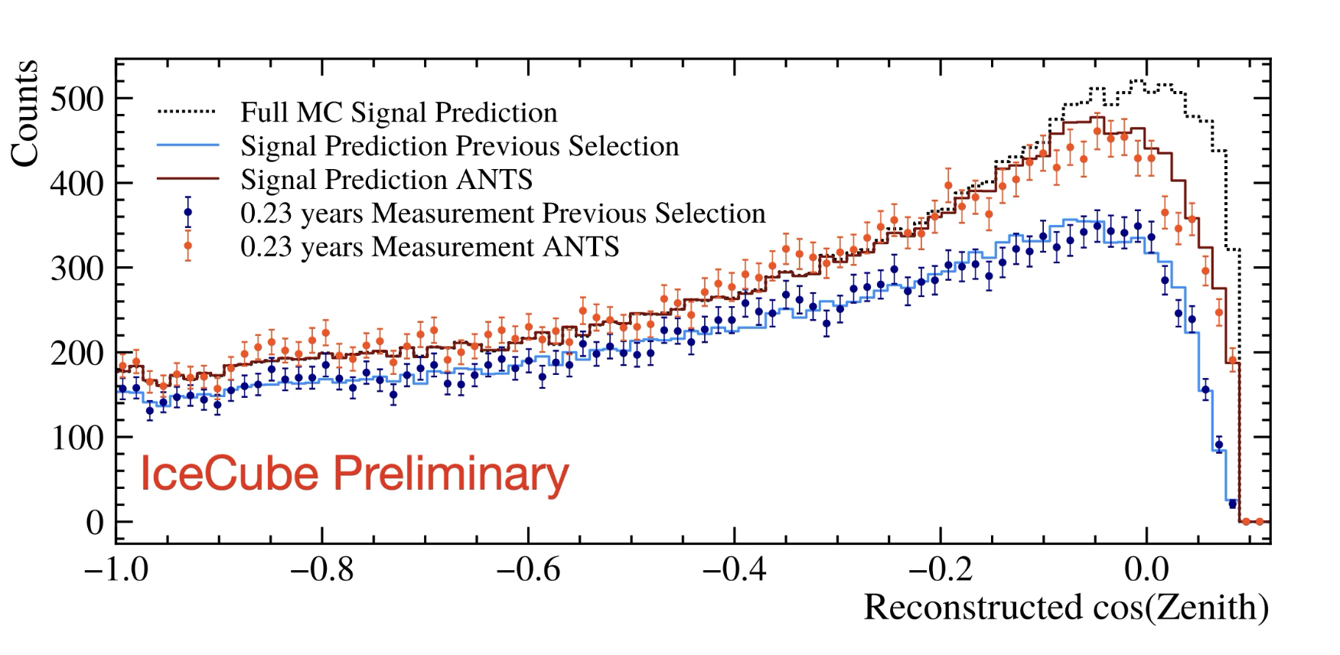
Muon Event Selection with Transformers
25% increase in efficiency at 95% purity

Slide 13
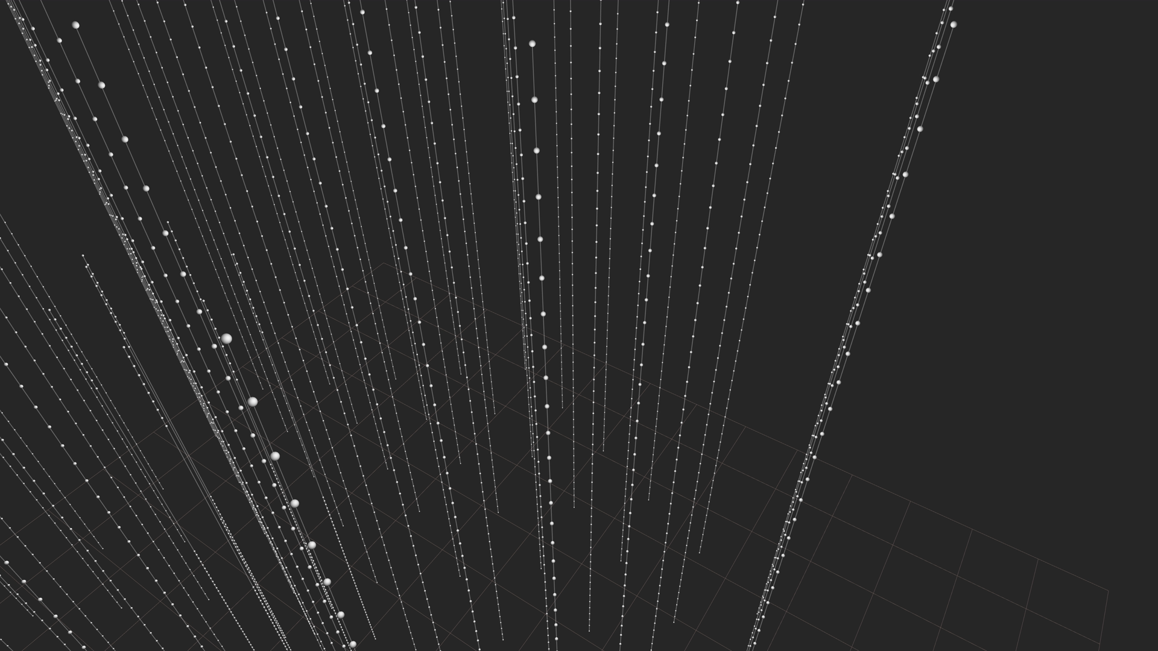
Cascade in Ice
Color: Time delay compared to direct light (red = direct light)
Calorimetric measurement of the energy: Good angular resolution
Small lever arm: Challenging directional reconstruction

Slide 14
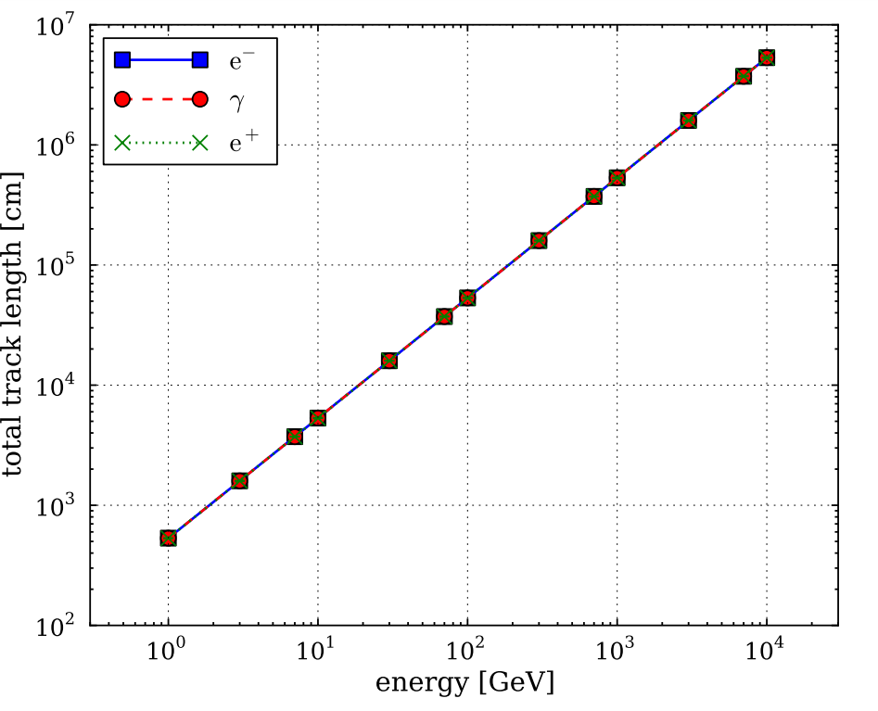
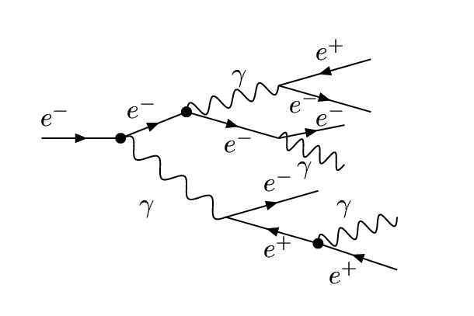
Cherenkov Light Yield for EM Cascades
https://arxiv.org/abs/1210.5140
Cascade → Sum of Cherenkov „tracks“
Light Yield
Light yield proportional
to initial energy
Cherenkov angle
~250 photons / cm between 300nm and 500nm
A bit more complicated for hadronic cascades
(heavy particles below Cherenkov threshold)

Slide 15
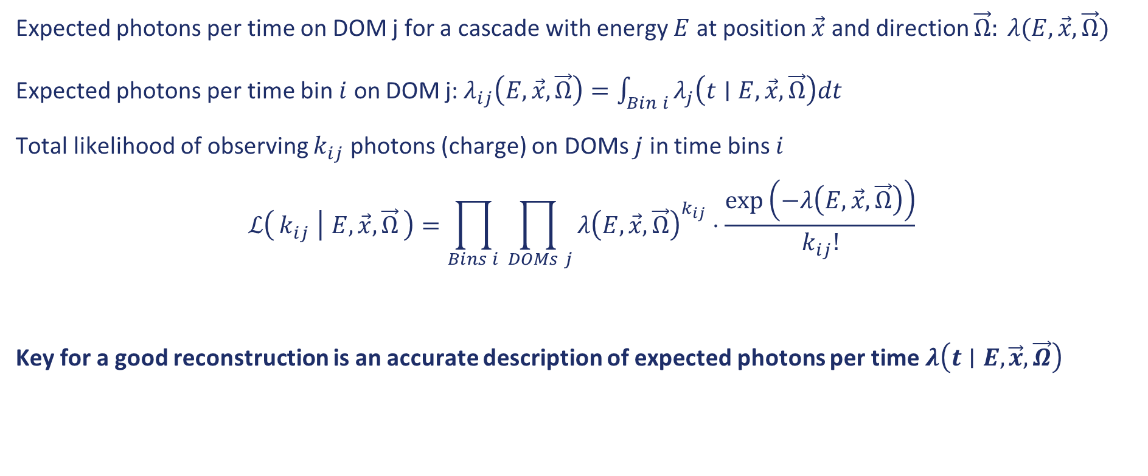
Likelihood Model
Expected photons per time on DOM j for a cascade with energy $E$ at position $\vec{x}$ and direction $\vec{Ω}: λ(E,\vec{x},\vec{Ω})$
Expected photons per time bin $i$ on DOM j:$λ_{ij}\left(E, \vec{x},\vec{Ω}\right)=\int_{Bin i}{λ_{j}\left(t∣E, \vec{x},\vec{Ω}\right)dt}$
Total likelihood of observing $k_{ij}$ photons (charge) on DOMs $j$ in time bins $i$
$$ℒ\left(k_{ij} ∣ E, \vec{x},\vec{Ω}\right)=\prod_{Bins i}{\prod_{ DOMs j}{{λ\left(E,\vec{x},\vec{Ω}\right)}^{k_{ij}}⋅\frac{\exp\left(−λ\left(E,\vec{x},\vec{Ω}\right)\right)}{k_{ij}!}}}$$
Key for a good reconstruction is an accurate description of expected photons per time $λ\left(t∣E,\vec{x},\vec{Ω}\right)$

Slide 16
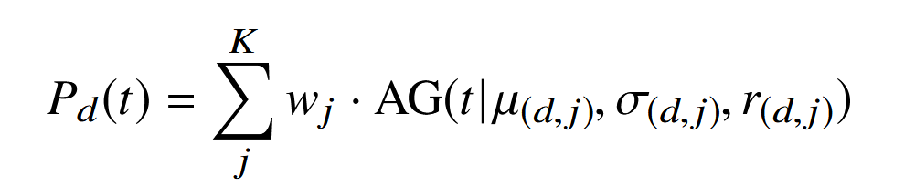
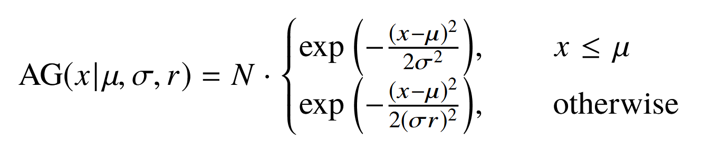
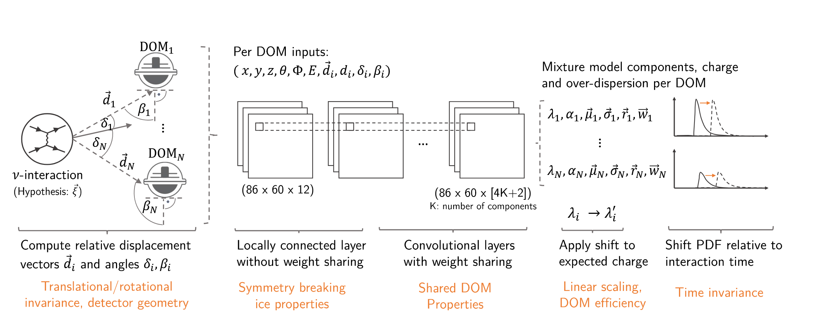


Hybrid Reconstruction
DNN to predict the arrival time PDFs, trained on simulated events
$$λ\left(t\right)=$$
$w, μ,σ,r$ are DNN outputs
DOI: 10.22323/1.395.1065

Slide 17
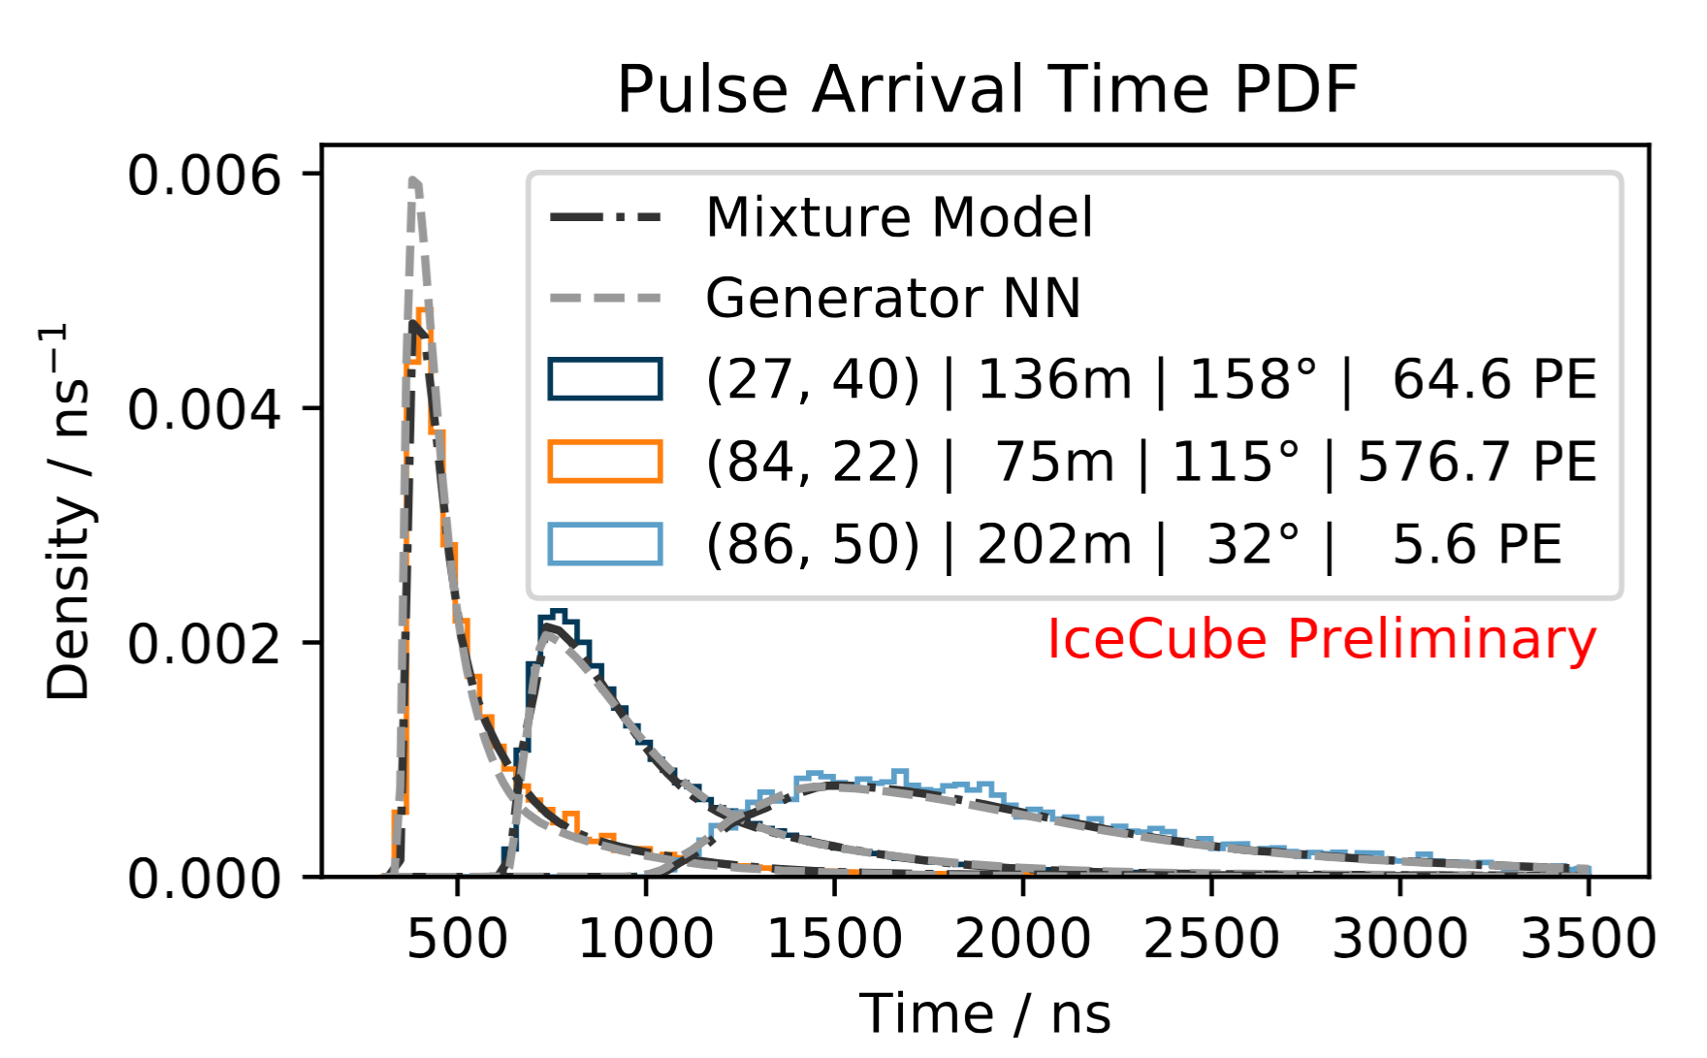
Mixture Model PDFs
DOI: 10.22323/1.395.1065

Slide 18
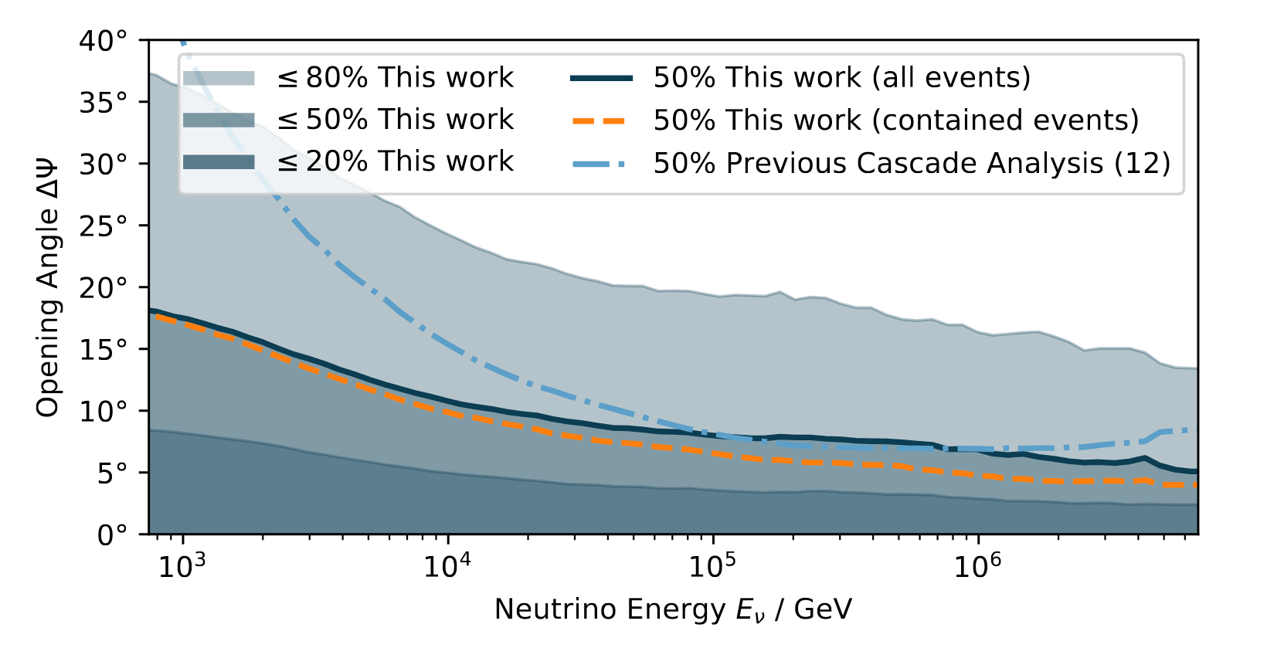
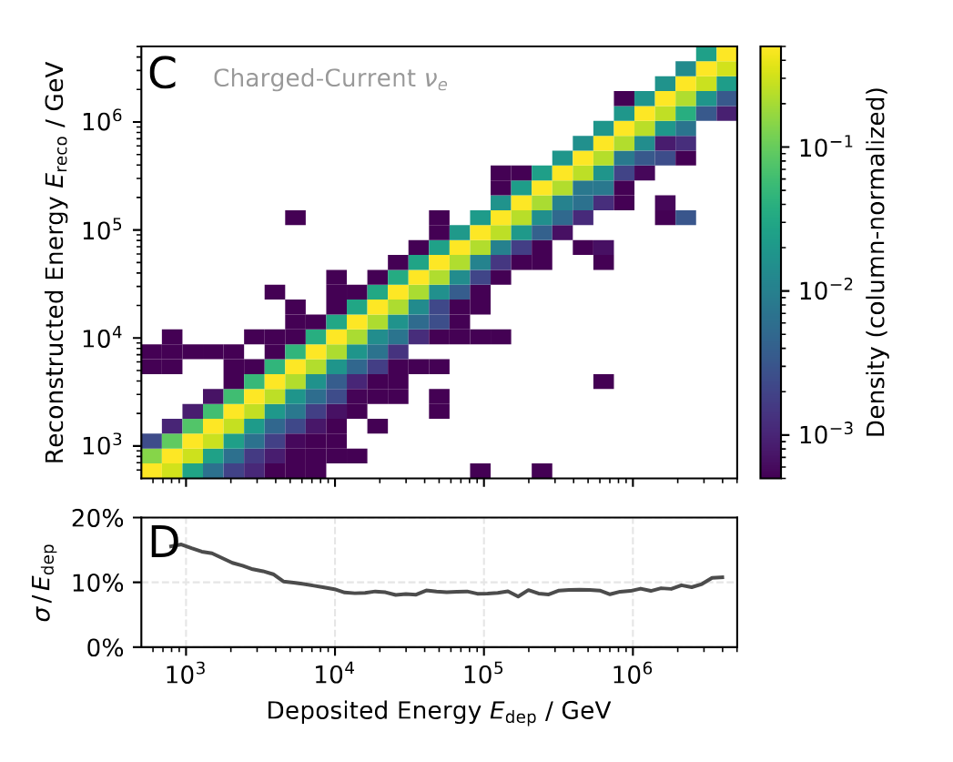
Cascade Resulutions (DNN PDFs)
https://doi.org/10.1126/science.adc9818

Slide 19
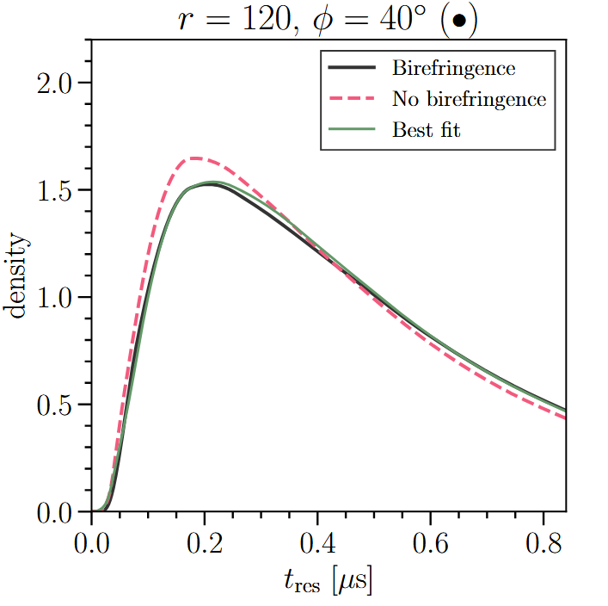
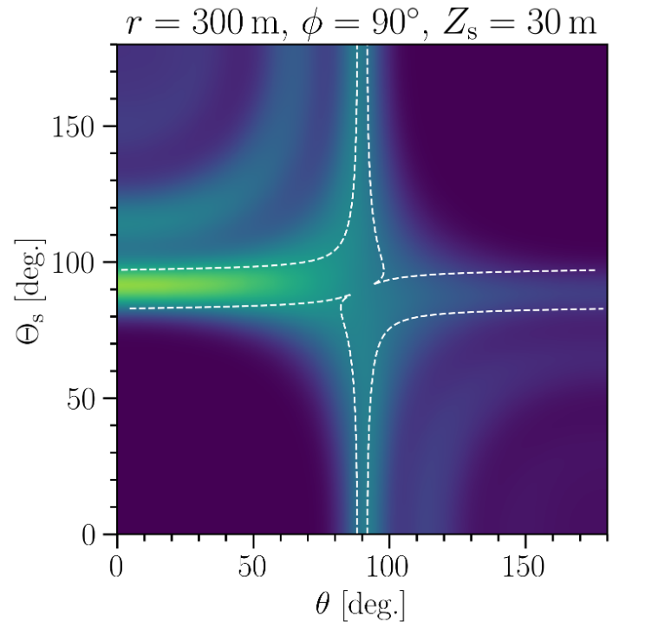
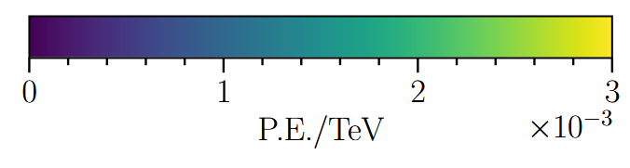

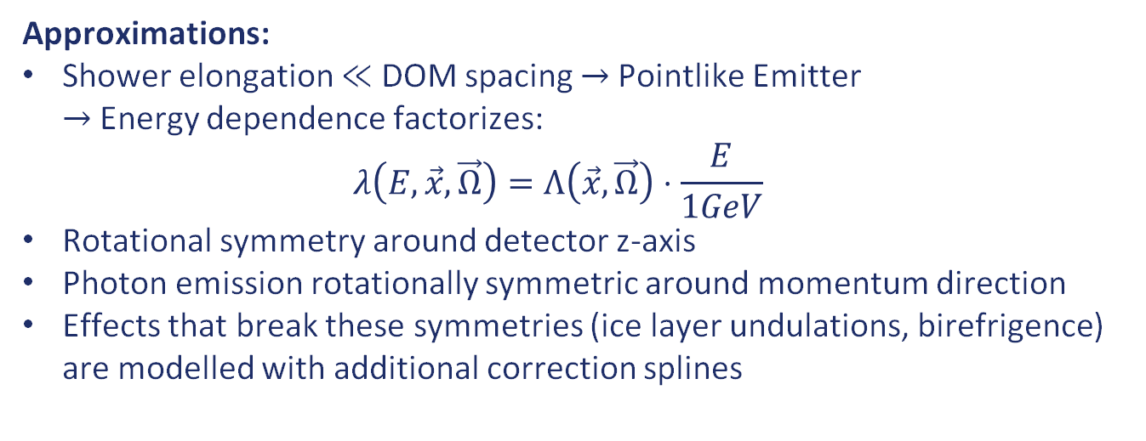
Splined Photon Arrival Time PDFs
MC Photon Tracking
Tabulate DOM response
B-Spline Interpolation
$λ\left(E,\vec{x},\vec{Ω}\right)$
Approximations:
Shower elongation $≪$ DOM spacing $→$Pointlike Emitter
$→$Energy dependence factorizes:
$λ\left(E,\vec{x},\vec{Ω}\right)=Λ\left(\vec{x}, \vec{Ω}\right)⋅\frac{E}{1GeV}$
Rotational symmetry around detector z-axis
Photon emission rotationally symmetric around momentum direction
Effects that break these symmetries (ice layer undulations, birefrigence) are modelled with additional correction splines
https://doi.org/10.1088/1748-0221/19/06/P06026

Slide 20
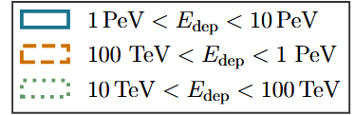
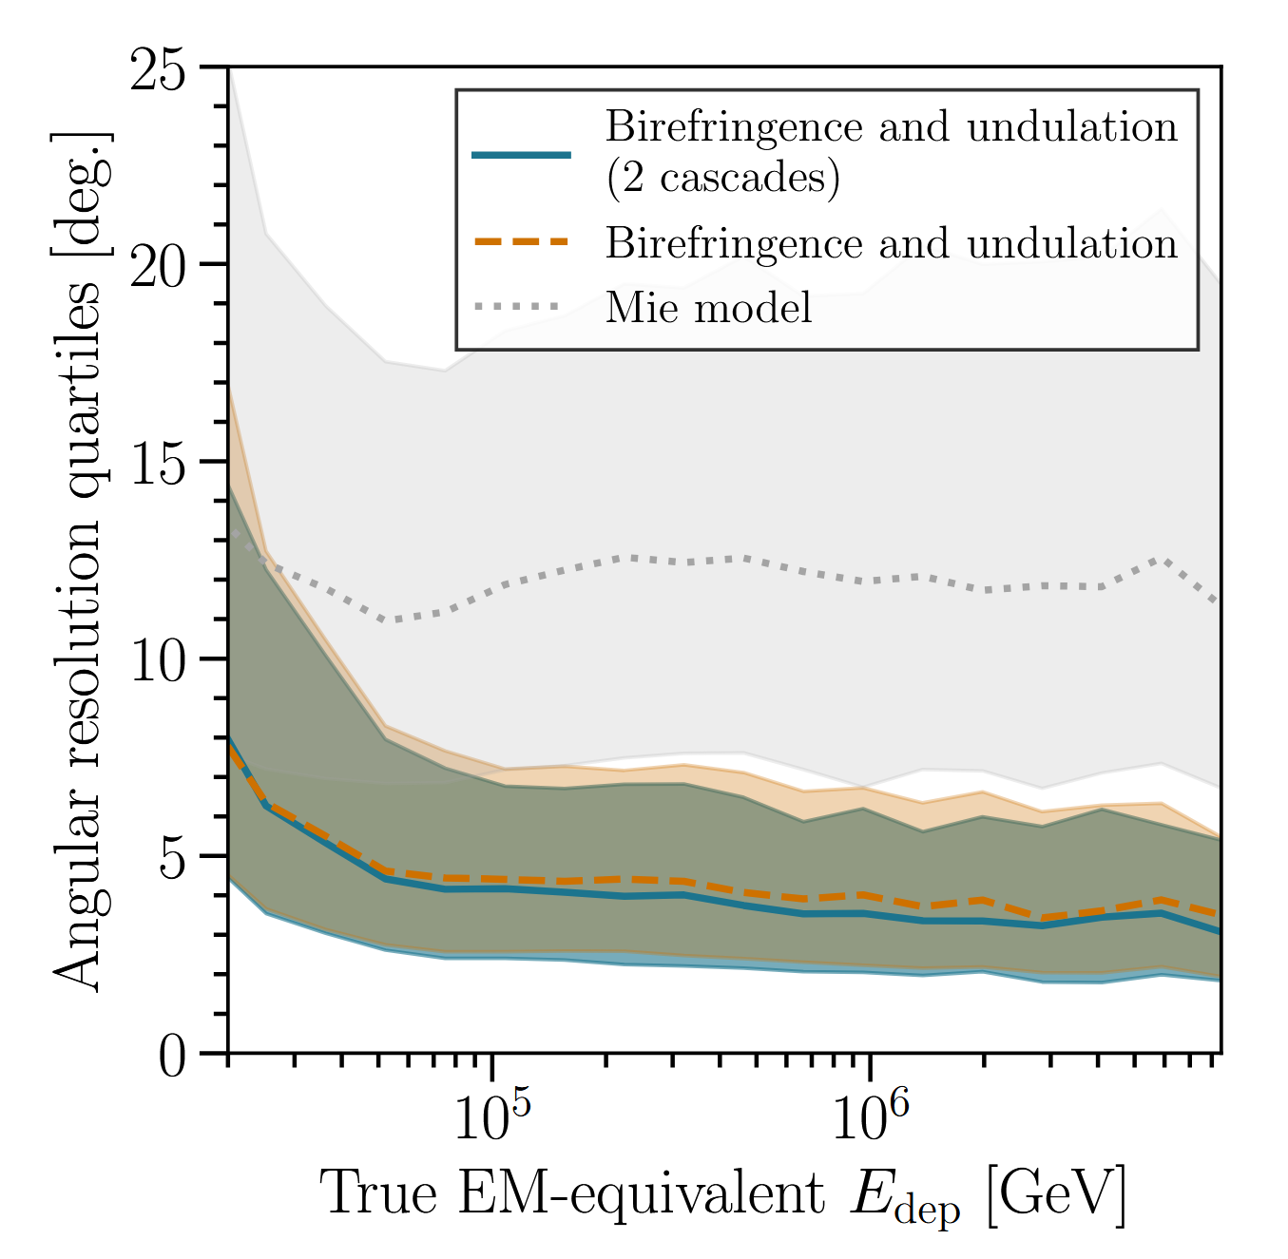
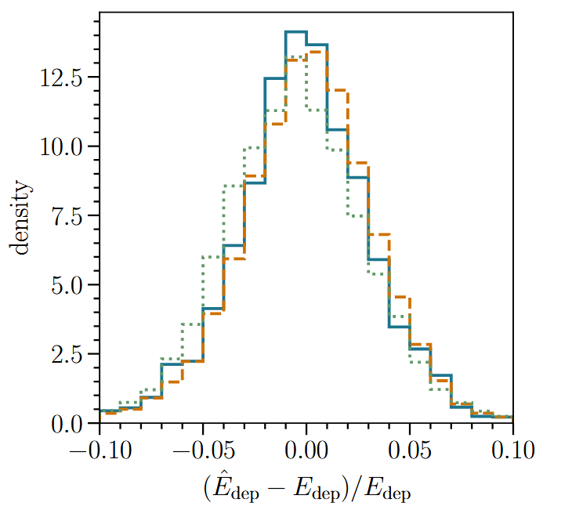
Cascade Resolutions (Splined LUT)
https://doi.org/10.1088/1748-0221/19/06/P06026

Slide 21
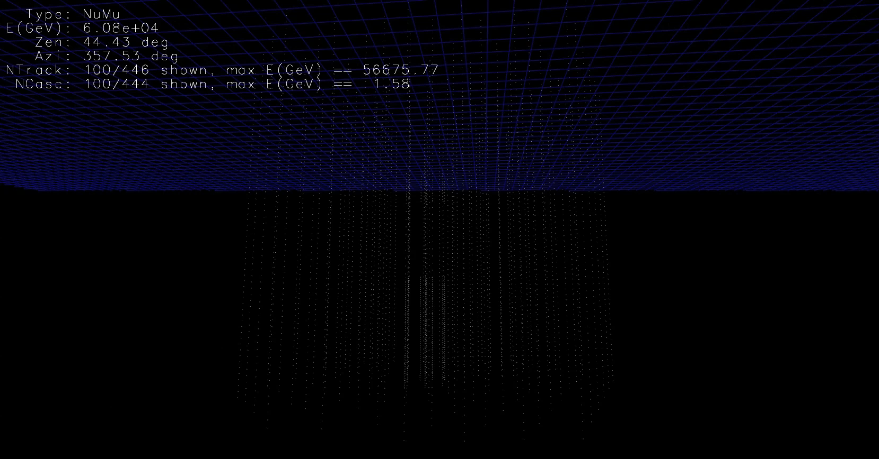
Muon in IceCube
Can only measure dE/dX: Poor angular resolution
Large lever arm: Excellent directional reconstruction

Slide 22

Energy Losses of High-Energy Muons
$$μ$$
At high energies, the light yield of muons is dominated by stochastic energy losses
Stochastic Losses

Slide 23
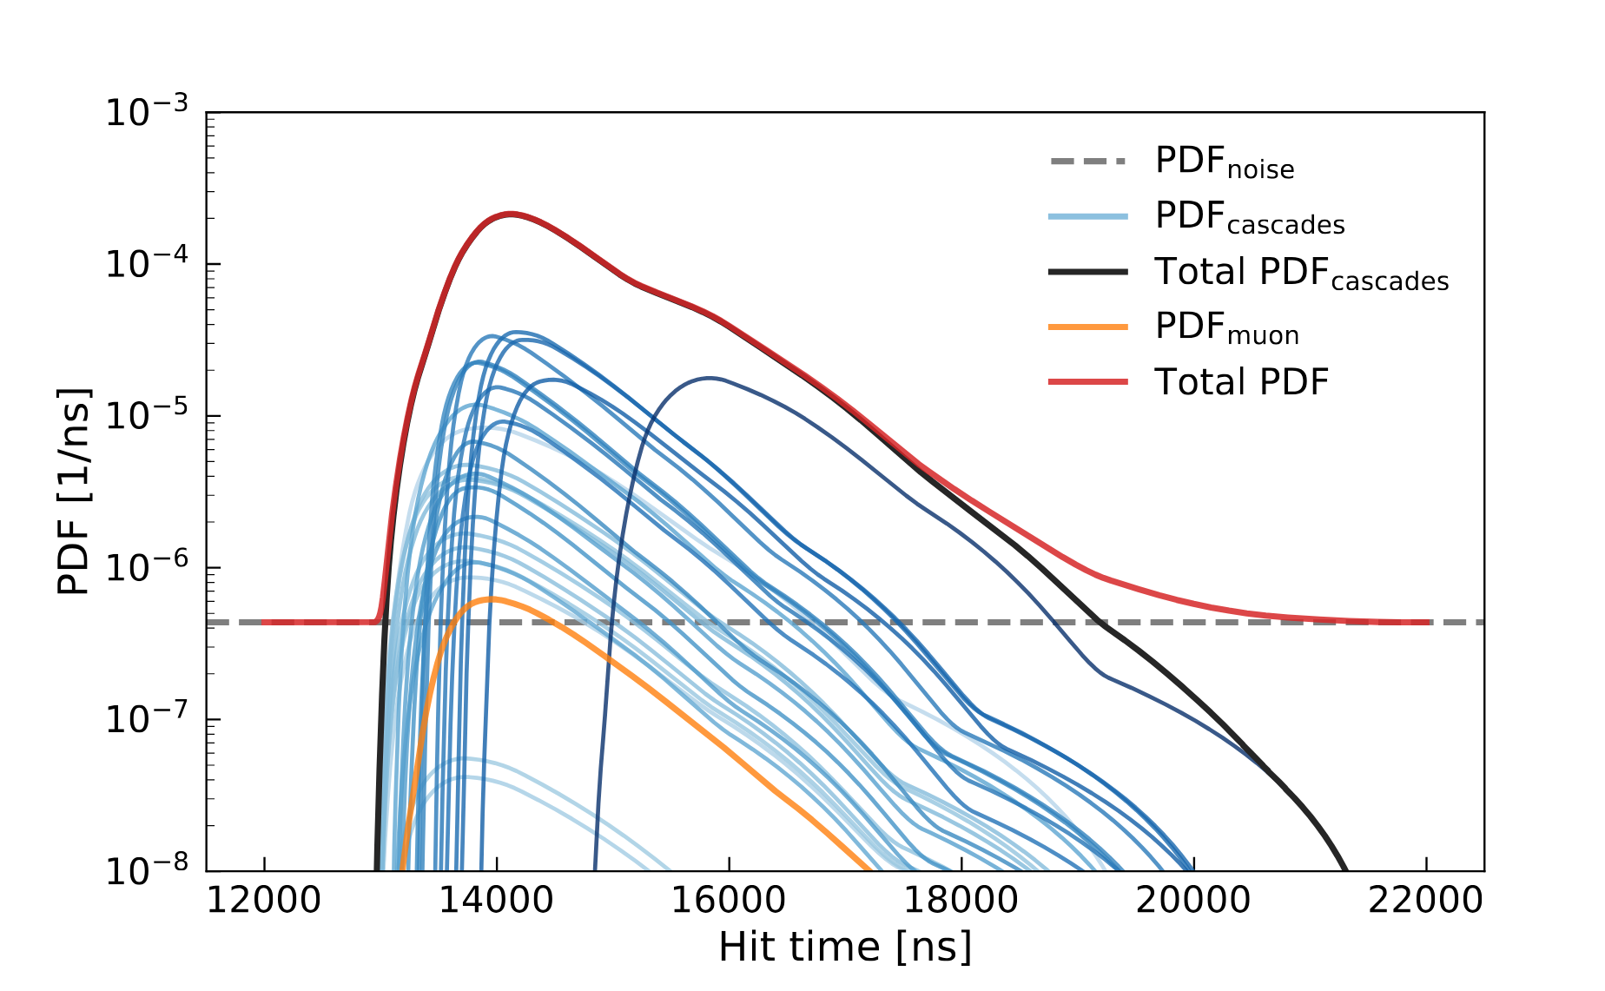
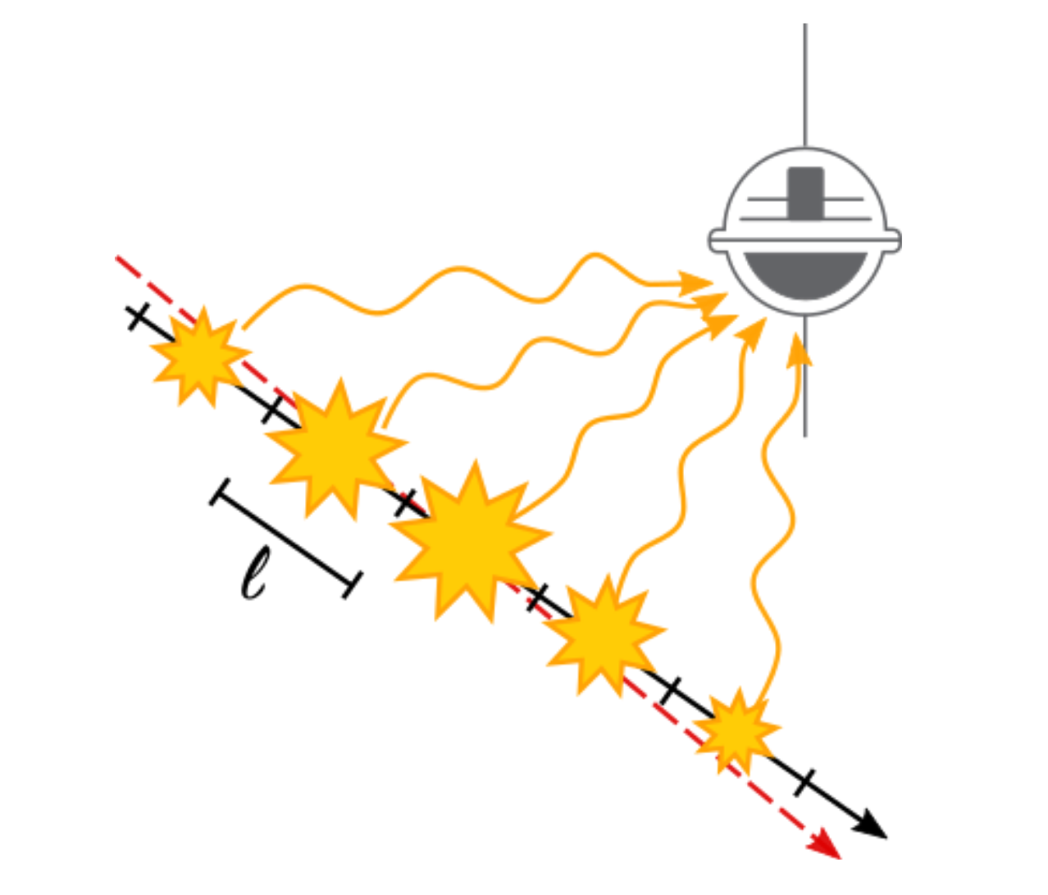
Lightyield of stochastic muons
DOI 10.1088/1748-0221/16/08/P08034
Stochastic losses can significantly change the time profile of measured photons
Directly modelling the stochastic losses in a likelihood is hard: Parameter space is high-dimensional (position & energy of each stochastic loss)

Slide 24
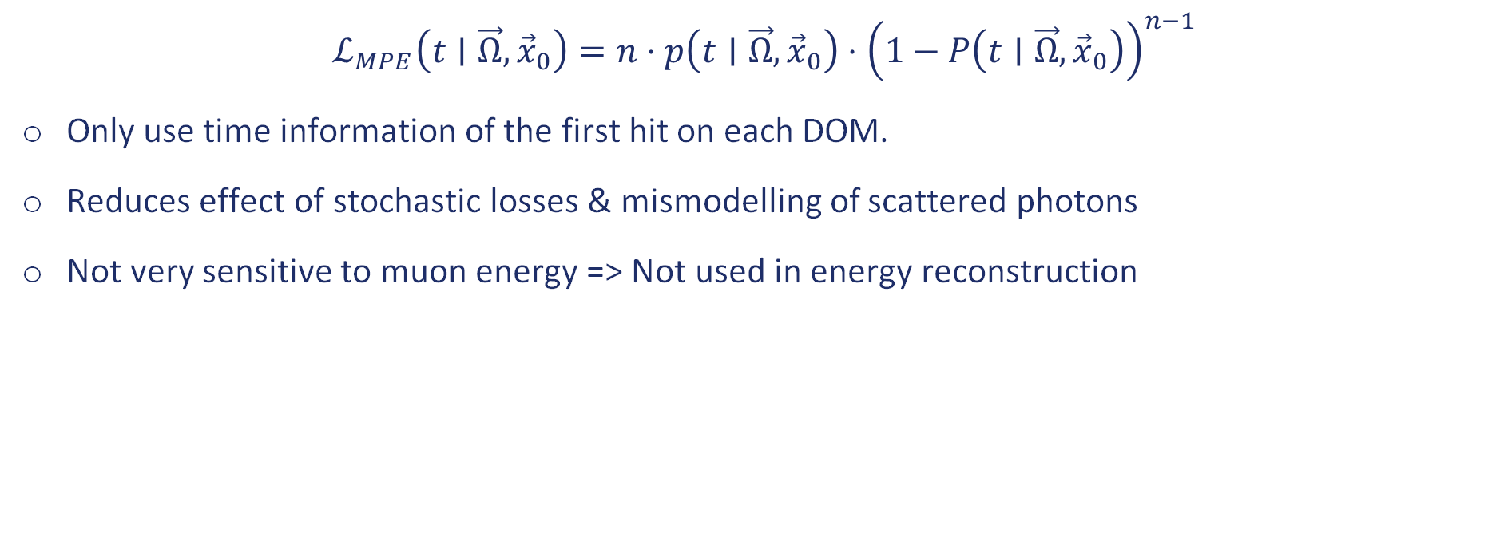
MPE-Likelihood
$$ℒ_{MPE}\left(t∣\vec{Ω},{\vec{x}}_{0}\right)=n⋅p\left(t∣\vec{Ω},{\vec{x}}_{0}\right)⋅{\left(1−P\left(t∣\vec{Ω},{\vec{x}}_{0}\right)\right)}^{n−1}$$
Only use time information of the first hit on each DOM.
Reduces effect of stochastic losses & mismodelling of scattered photons
Not very sensitive to muon energy => Not used in energy reconstruction

Slide 25
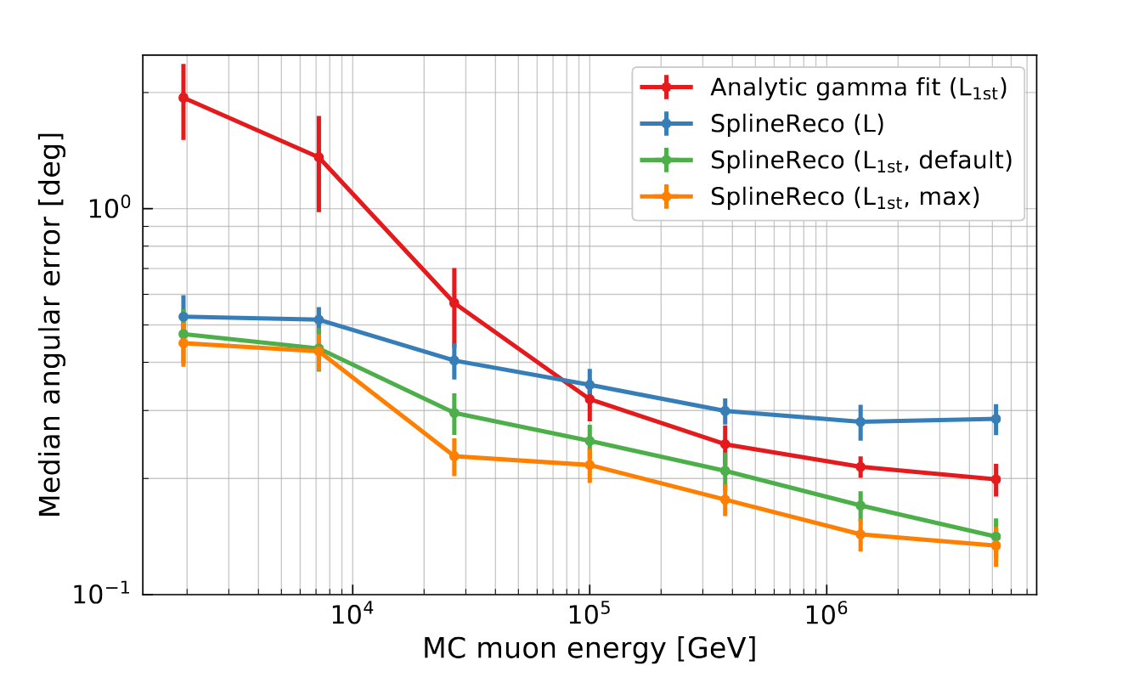
Muon Angular Resolutions with SplineMPE
Empircal modifications to algorithm („max“)
to account for muon stochasticity:
Light yield PDFs generated by averaging over many energy loss profiles
Rejecting hits which likely originate from stochastic losses (via KS-test metric)
Convolving the time-pdf with a gaussian distribution
https://arxiv.org/pdf/2103.16931

Slide 26
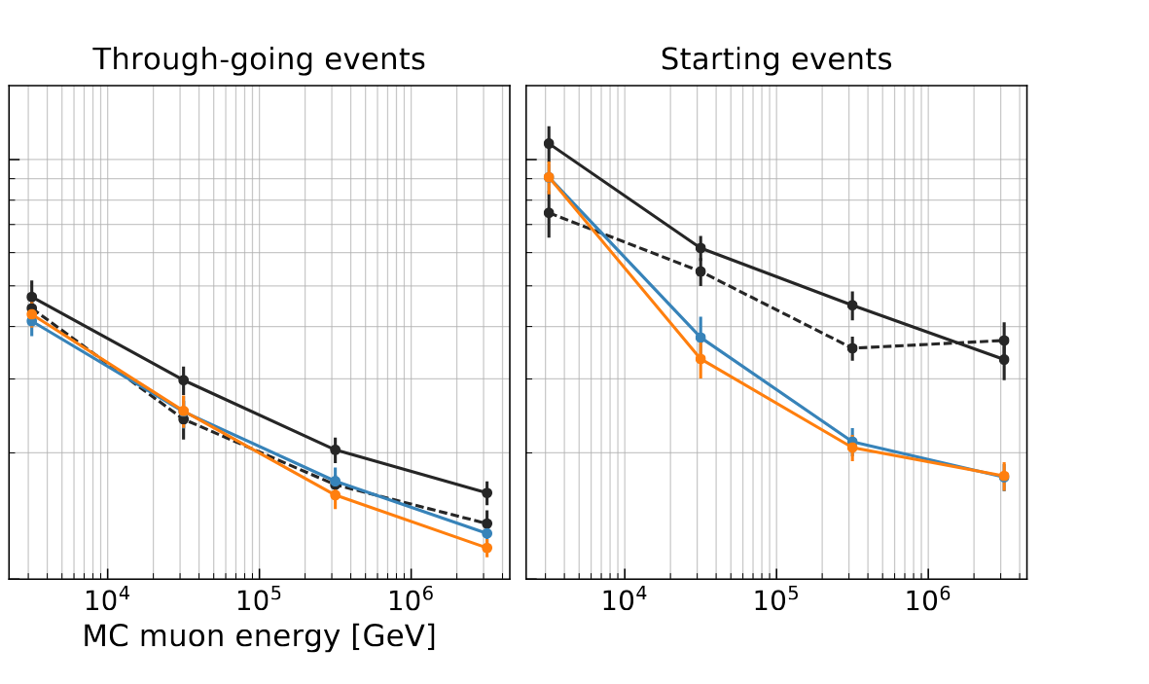
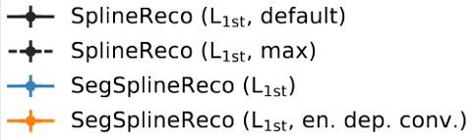
Segmented Spline Reco
https://arxiv.org/pdf/2103.16931
Median Angular Error [deg]
By segmenting the track hypothesis into a series of cascades, angular resolution can be further improved at the cost of longer runtime

Slide 27


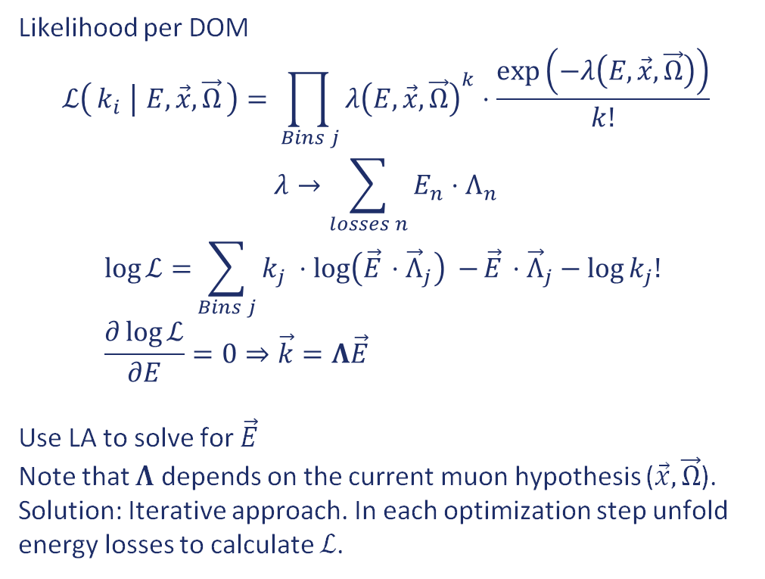

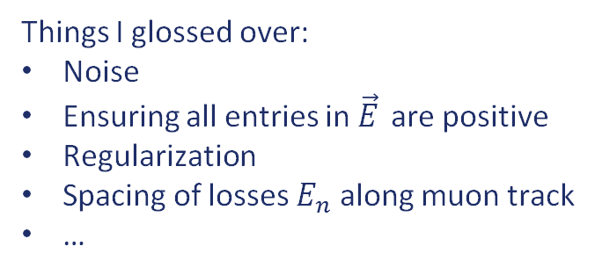
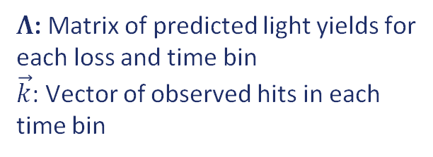
Energy Loss Unfolding (Millepede)
Likelihood per DOM
$$ℒ\left(k_{i} ∣ E, \vec{x},\vec{Ω}\right)=\prod_{ Bins j}{{λ\left(E,\vec{x},\vec{Ω}\right)}^{k}⋅\frac{\exp\left(−λ\left(E,\vec{x},\vec{Ω}\right)\right)}{k!}}$$
$$λ→\sum_{losses n}{E_{n}⋅Λ_{n}}$$
$$\log{ℒ=}\sum_{Bins j}{k_{j} ⋅\log\left({\vec{E}}_{ }⋅{\vec{Λ}}_{j}\right) −}{\vec{E}}_{ }⋅{\vec{Λ}}_{j}−\log{k_{j}! } \\ \frac{∂\log{ℒ}}{∂E}=0⇒\vec{k}={Λ\vec{E}}_{ }$$
Use LA to solve for $\vec{E}$
Note that $Λ$ depends on the current muon hypothesis ($\vec{x},\vec{Ω}$).
Solution: Iterative approach. In each optimization step unfold energy losses to calculate $ℒ$.
$E_{1}$
$E_{2}$
$E_{n}$
$Λ$: Matrix of predicted light yields for each loss and time bin
$\vec{k}$: Vector of observed hits in each time bin
Things I glossed over:
Noise
Ensuring all entries in ${\vec{E}}_{ }$ are positive
Regularization
Spacing of losses $E_{n}$ along muon track
…
https://arxiv.org/pdf/1311.4767

Slide 28
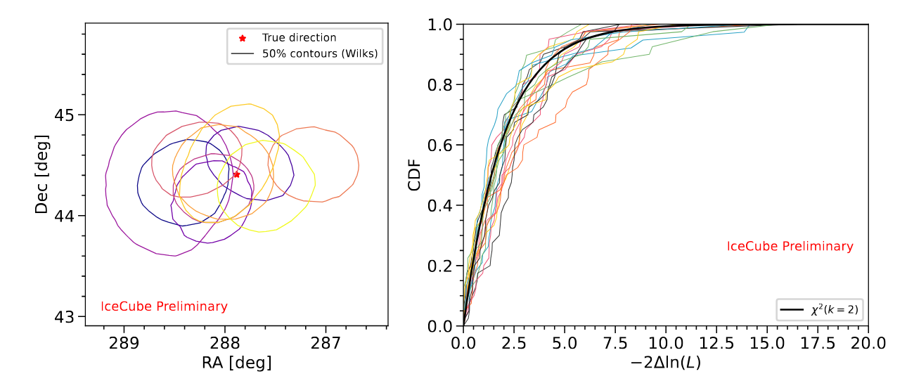
Angular Uncertainty Estimation
Likelihood with energy loss unfolding (Millipede) is a good model of the underlying physics
=> Uncertainty regions obtained from likelihood scan follow expectation from Wilks’ Theorem
Algorithm is used in IceCube’s realtime alert system to provide ROIs for telescope follow-ups
https://arxiv.org/abs/2507.06957

Slide 29
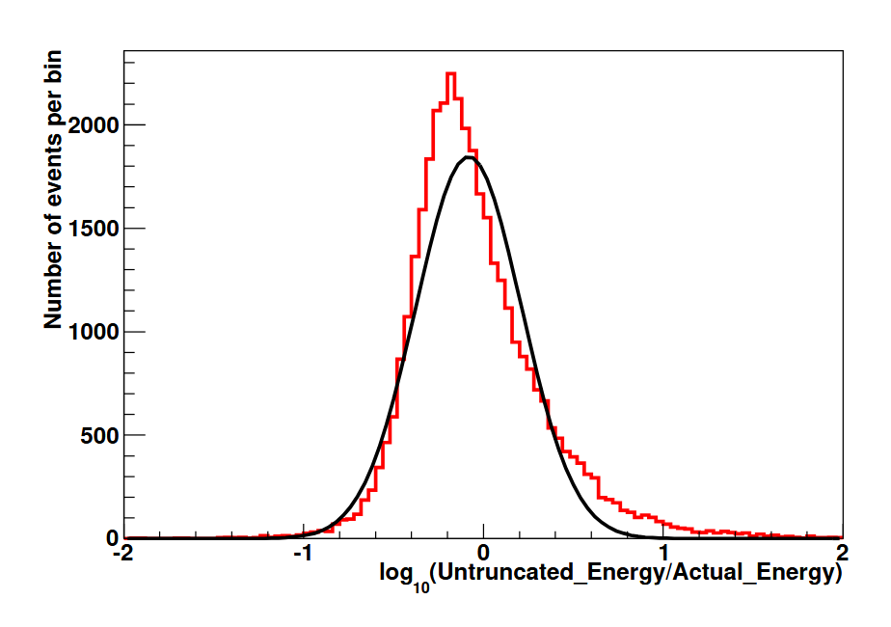





Truncated Mean dE/dx
$Λ\left(\vec{x},\vec{Ω}\right)$: Expected photons for 1GeV energy loss per m
At each DOM calculate$E_{i}=\frac{Λ\left(\vec{x},\vec{Ω}\right)}{k}$
$<\frac{dE}{dx}>=\frac{1}{N}\sum_{DOMs i}{E_{i}}$
Stochastic losses lead to tail in distribution, biasing$<\frac{dE}{dx}>$
Bias (and thus resolution) can be improved by removing the highest 50% of DOMs from the mean
$$σ=0.29$$
$σ=0.2$2

Slide 30



DNN Energy Reconstruction
https://pos.sissa.it/358/937
DNN improves resolution in transition regime between continuous and stochastic dE/dx
https://doi.org/10.1126/science.abg3395
ResNet Vision Model

Slide 31



Normalizing Flows
Given a base distribution $p_{0}$ and an invertible function $f$ parametrized by a neural network $g_{θ}$ we can model any conditional PDF using a normalizing flow:
$$p\left(x ∣ y\right)=p_{0}\left(f_{g_{θ}\left(y\right)}^{−1}(x)\right)⋅\left|\det{J_{g_{θ}\left(y\right)}^{−1}}(x)\right|$$
If $x$ is a reconstruction quantity of interest (such as the event direction), we can use the data $y$ to learn the posterior PDF.
Useful for estimating non-gaussian / asymmetric uncertainty regions
(Publication in preparation)
https://arxiv.org/pdf/2309.16380

Slide 32





Kaggle Competition
Slide by Philipp Eller
Simulated neutrino interactions in IceCube
Energies from 100 GeV to 100 PeV
Different flavours and interaction types
→ One of the biggest kaggle datasets ever!
  > 100 Million events in training set
  1 Million events for scoring
Tracks
Cascades
„bad“ events

Slide 33


Kaggle Competition
Slide by Philipp Eller
6,460 people registered
901 participants handed in at least one valid solution
100 first time kagglers
At competition close 812 teams
grand total of 11,206 solutions were submitted
competitors around the globe from 74 countries
Two papers:
https://arxiv.org/abs/2307.15289
https://arxiv.org/abs/2310.15674
Top 5 Countries:
10

Slide 34
Summary
At high energies (above 100 TeV), IceCube is able to reconstruct cascades with <5° and tracks with <0.2° angular resolution
Success of ML-based reconstruction models has inspired efforts to improve „classical“ likelihood-based reconstructions
Both techniques rely on accurate forward MC simulations which requires a precise understanding of the detector medium
„New“ ML techniques are coming (Transformers, Normalizing flows, …) – stay tuned!

Slide 35
Backup

Slide 36




Modelling the ice in IceCube
What happens to photons in ice?
They scatter (via Mie scattering on dust)
-> Mean free path over $n$ multiple scatters: $λ_{e}= \frac{λ_{s}}{1−\left\langle \cos{θ}\right\rangle }$
-> A photon will scatter at an angle $θ$ given by a PDF $p(\cos{θ})$
They get absorbed (via three different absorption mechanisms)
  -> Ice models use the absorption coefficient :
$$a\left(λ\right)=A_{U}e^{−B_{U}λ}+C_{dust}λ^{−κ}+A_{IR}e^{{−λ_{o}}/λ}$$
“Urbach tail”:
electronic bandgap-thingy...
Effective at $λ$ <200 nm
Absorption by dust particles:
Depends on the dust concentration
Effective at $λ⊂[200,500]$ nm
IR light excites vibro-rotational modes of $H_{2}O$
Effective at $λ$>500 nm

Slide 37

Depth Dependency

Slide 38



Energy Losses of High-Energy Muons
$$\frac{dE}{dX}=a+b\left(E\right)∗E$$
Stochastic losses
dominate
Continuous Losses
(Ionization)
Stochastic Losses
(Bremsstrahlung, Photohadronic,
Pair Production)

Slide 39

Recording PMT Waveforms in IceCube
PMT signal cannot be continuously digitized.
Back-of-the-envelope calculation:
Need ~ns resolution.
Even with 1 bit (PMT current on/off) this results in 1Gbit / s per DOM.
5000 DOMs -> 5TBits / s for the entire detector.
Triggering: Only record „interesting“ data.
For IceCube, triggering is employed already at the lowest level: Only when the PMT current is above a certain threshold, data recording is started (a „DOM Launch“)

Slide 40

Ice Layer Undulations
DOI 10.1088/1748-0221/19/06/P06026

Slide 41


Ice Birefrigence
https://doi.org/10.5194/tc-18-75-2024

Slide 42



Splined Photon Arrival Time PDFs
Deposited Energy
Vertex Position
DOM Position
Momentum direction
Approximations:
Elongation $≪$ DOM spacing $→$Pointlike Emitter
$→$Energy dependence factorizes:
$λ\left(E,\vec{x},\vec{Ω}\right)=Λ\left(\vec{x}, \vec{Ω}\right)⋅\frac{E}{1GeV}$
Rotational symmetry around detector z-axis
Photon emission rotationally symmetric around momentum direction
Shower Elongation: $l∝\log{E}$

Slide 43

Energy Loss Unfolding

Slide 44



Fast Low Energy Reco using CNNs

Slide 45
Expected Charge / Time distributions for Cascades
1 GeV EM Cascade
https://arxiv.org/pdf/1311.4767
Observation angle

